Slide 1


Broadband Update
UP Association of
County Commissioners
May 05, 2022

Slide 2
MEDC, LEO and Connect Michigan
Technical Assistance and Planning
Primary tasks
Serve as the state’s primary point of contact for broadband and establish an online clearinghouse for broadband and technology resources.
Establish and facilitate a state-level taskforce to address the state’s broadband challenges.
Provide technical assistance and guidance to communities and ISPs through meetings, presentations, capacity building, and training.
Administer the Connecting Michigan Communities (CMIC) grant program.
Support the Michigan office of Highspeed Internet (MIHI).
Implement the Michigan Broadband Infrastructure Audit and Validation Project

Slide 3













Connecting Michigan Taskforce (CMIT)
Better coordinate broadband activity among state agencies;
Collectively advocate for Michigan broadband at the federal level; and
Review plans and recommendations to improve Michigan’s broadband ecosystem
Guidance
External Subject Matter Experts
Needs
Connecting
Michigan
Taskforce
State Broadband Strategy
TA and Resources
Resources
Needs
Communities &
Institutions

Slide 4
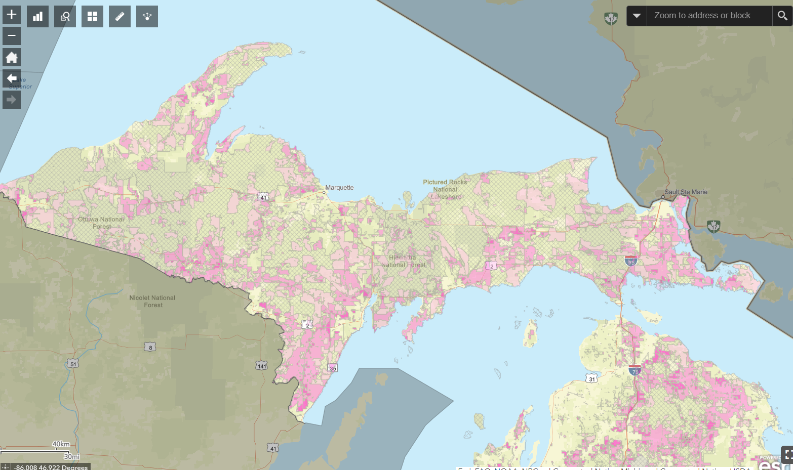
UP Map
Unserved 100Mbps Download & 10Mbps Upload
09-30-2021Data

Slide 5
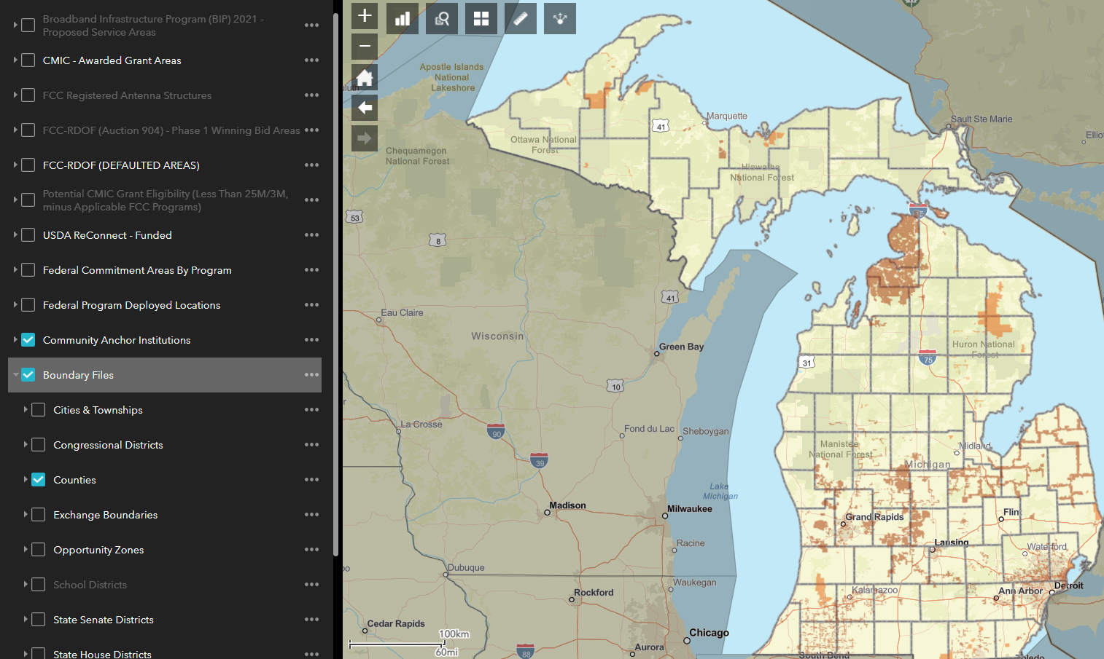
Fiber-100/20 Mbps- 1,000/1,000 Mbps

Slide 6
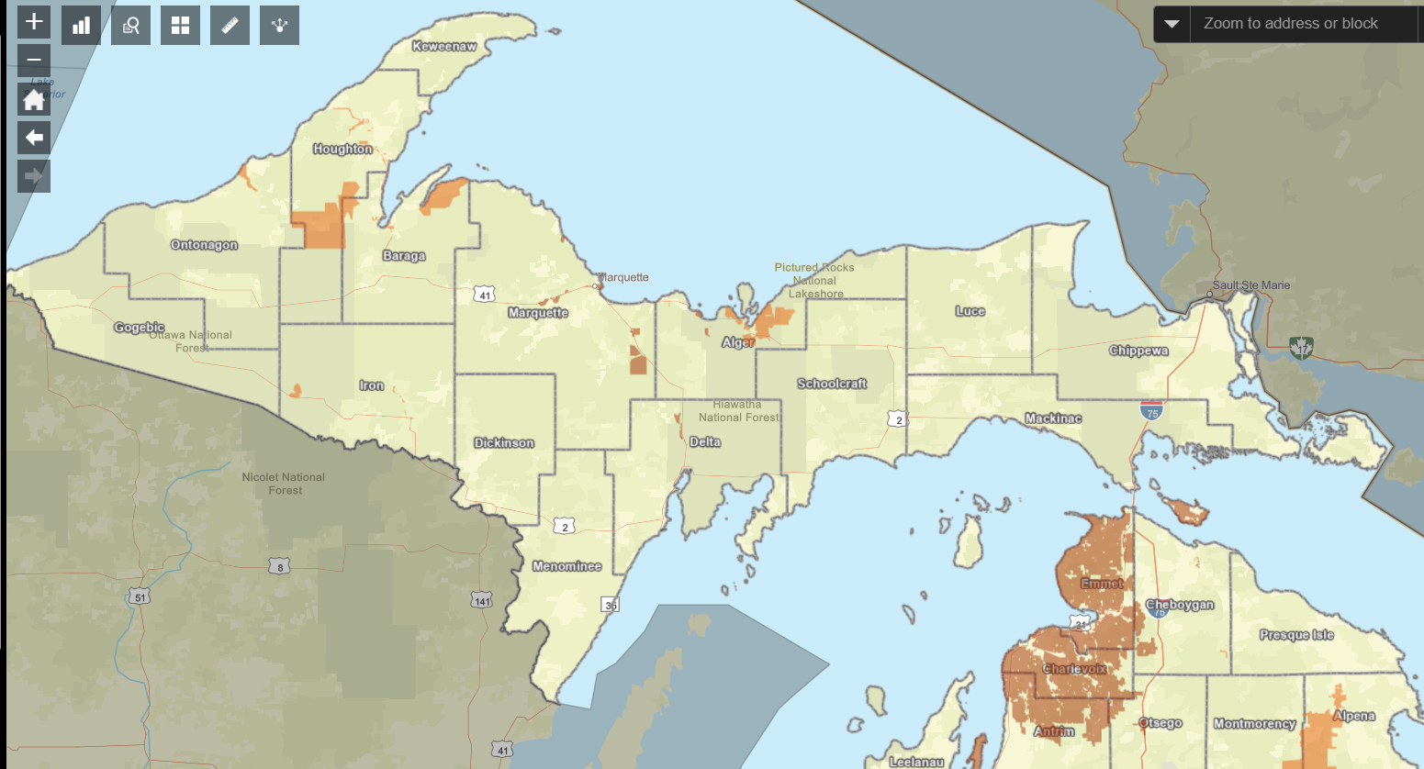
Fiber to the Home Networks

Slide 7
State Updates – May 2022
• LEO worked with the legislature to staff and fund the office the Michigan High Internet- MIHI- hiring 8 staff members to start
• Concurrently updated the state broadband strategic plan, however, this effort need to be revisited considering the state planning requirements in the new infrastructure bill
• NTIA is estimating that states will need to significantly increase capacity to implement the various components of the new infrastructure bill
• Launched Broadband Infrastructure Audit and Validation Project
Administered the Connecting Michigan Communities Grant Program $24 Million

Slide 8
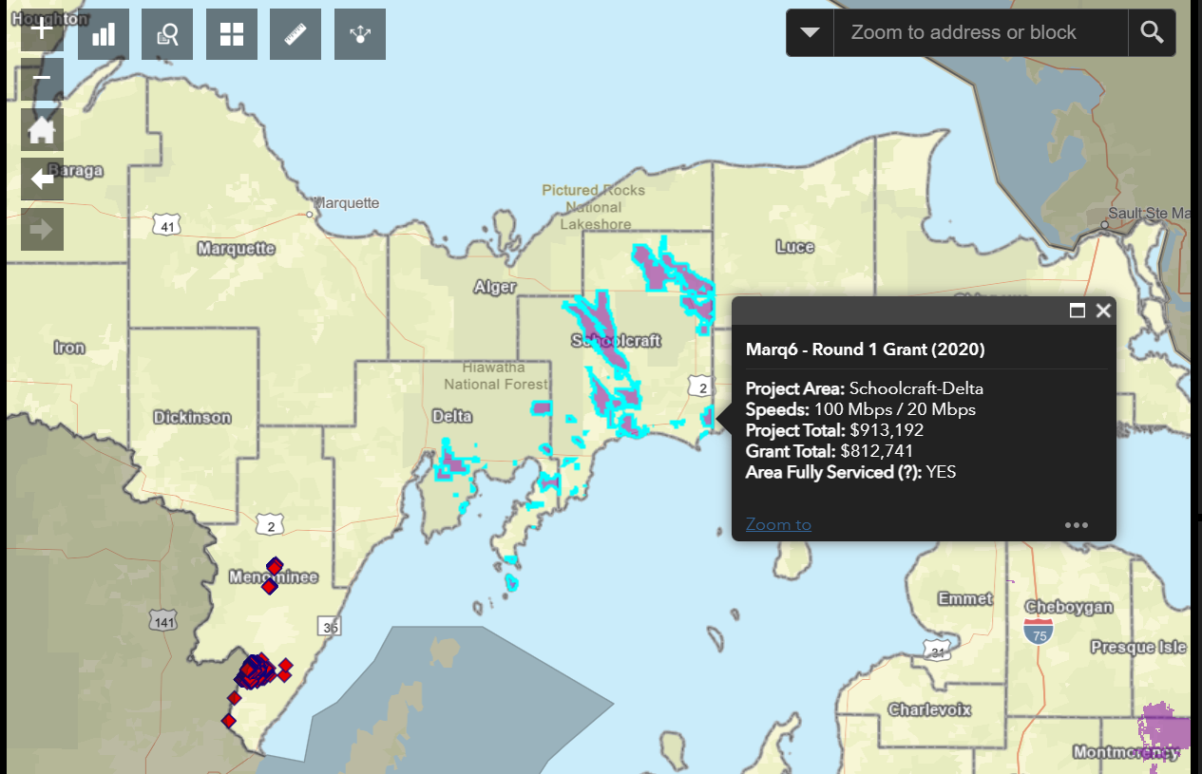
Connecting Michigan Communities (CMIC) Grants

Slide 9
State Updates – CPF- May 2022
Build Michigan Together Plan includes $250M from the ARPA Capital Projects Fund (CPF) for a new state broadband grant program- Issue checks spring 2023?
Focused mostly on deploying last mile connectivity at 100/20 Mbps, but up to $87.5M can be used to support middle mile projects
Allows up to 5% to be used for the state to administer the funds and staff the Michigan High-Speed Internet Office
Includes an objection process to prevent overbuilding, just like the current Connecting Michigan Communities grant program
Precludes government and educational entities from participating unless part of a public-private partnership
Projects must be complete by 2026
State must receive approval from US Treasury for this grant program before the program can begin

Slide 10



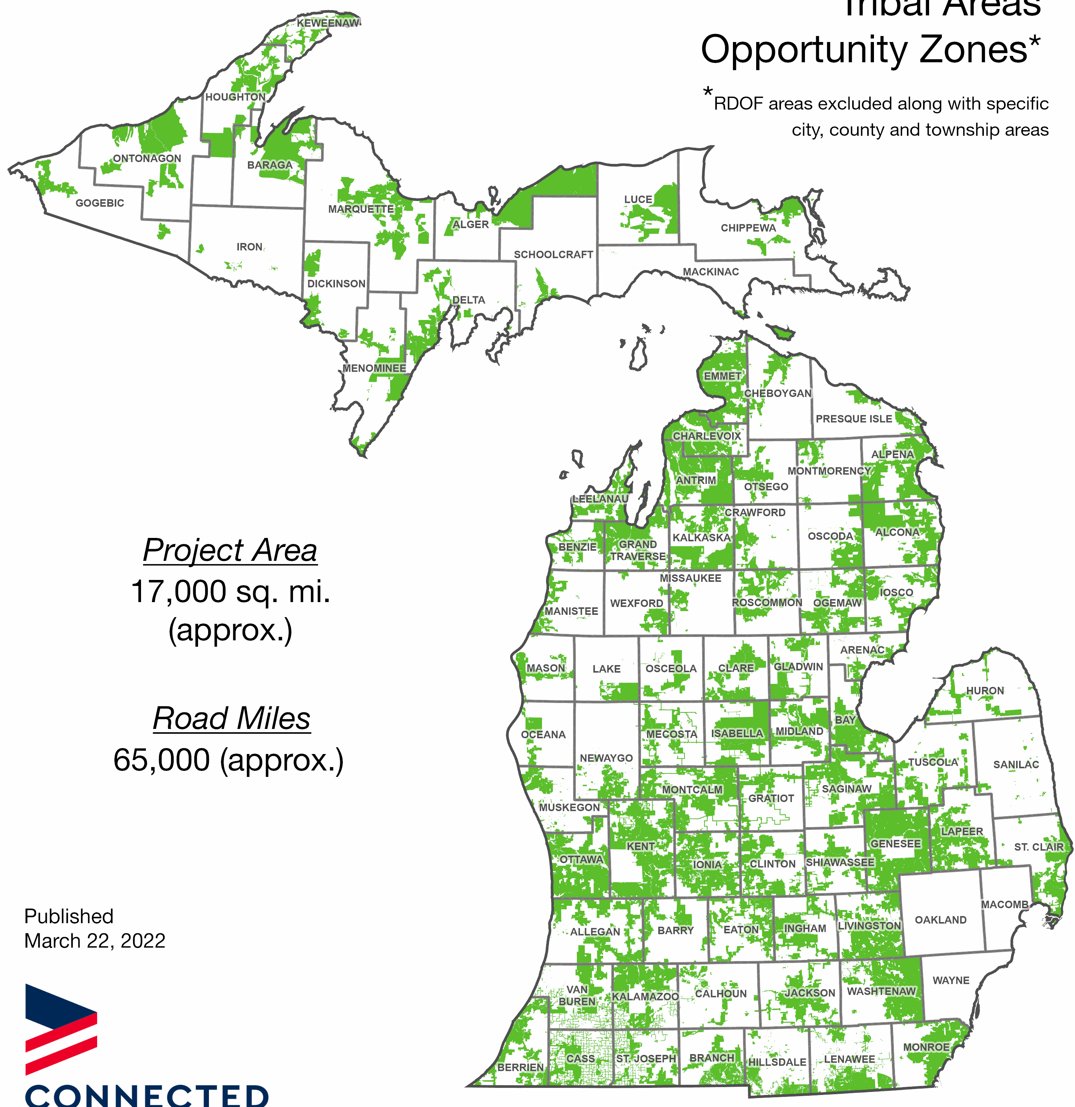
Michigan Broadband Infrastructure Audit and Validation Project
Field teams are concentrating on areas where we currently estimate 100/20 Mbps service to be available, (marked in green on the map).
Because the BEAD Program is focused on unserved and underserved areas first, we are concentrating on areas where we are less confident that relevant infrastructure exists and working to find where infrastructure stops.
Excludes:
City of Grand Rapids
City of East Grand Rapids
City of Kentwood
City of Wyoming
City of Grandville
City of Walker
City of Muskegon
City of Roosevelt Park
City of Muskegon Heights
City of Kalamazoo
City of Portage
City of Battle Creek
City of Lansing
City of East Lansing
City of Bay City
City of Essexville
Macomb County
Oakland County
Wayne County
Meridian Township (Ingham County)
Lansing Township (Ingham County)
City of Flint
Burton Township
Burton City
City of Flint
Flint Charter Township
City of Saginaw
Saginaw Township (Saginaw County)
Bridgeport Township (Saginaw County)
City of Midland

Slide 11
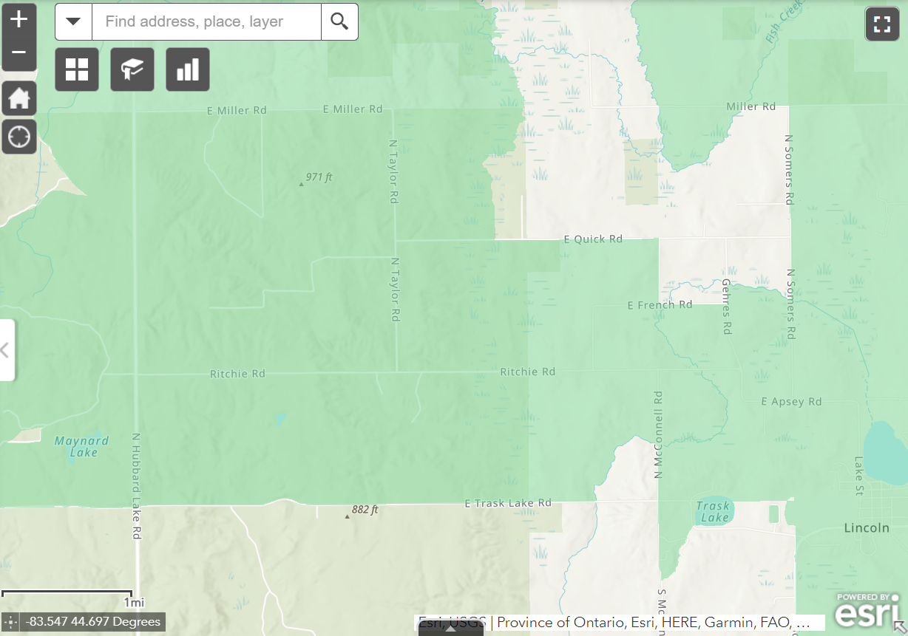
Michigan Broadband Infrastructure Audit and Validation Project
PROJECT OVERVIEW
Broadband mapping has traditionally relied on census blocks as the geographic unit for displaying availability
This can lead to overstatement and inaccuracies as census blocks grow in area as household density decreases.
Mapping wireless availability on blocks can lead to additional overstatement.
Map shows an area of Alcona County where 100/10 Mbps service is reported in the green highlighted areas.
Alcona County, Michigan

Slide 12
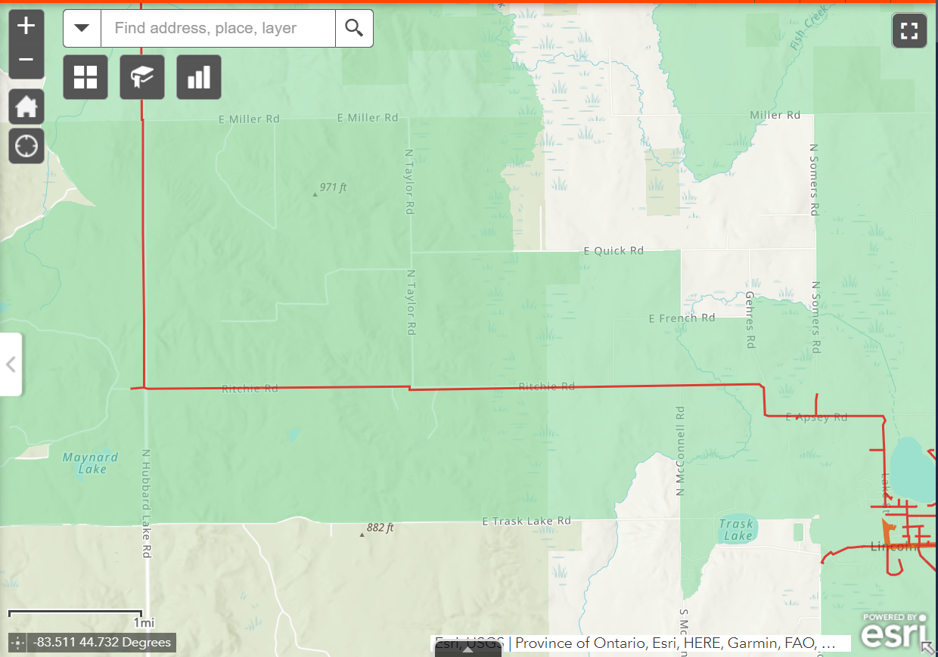
PROJECT OVERVIEW
Alcona County, Michigan
When we identify the actual location of broadband-supportive infrastructure in the right-of-way, we get a more accurate portrayal of service availability.
The map shows coax cable routes along roads in the same area of Alcona County.

Slide 13
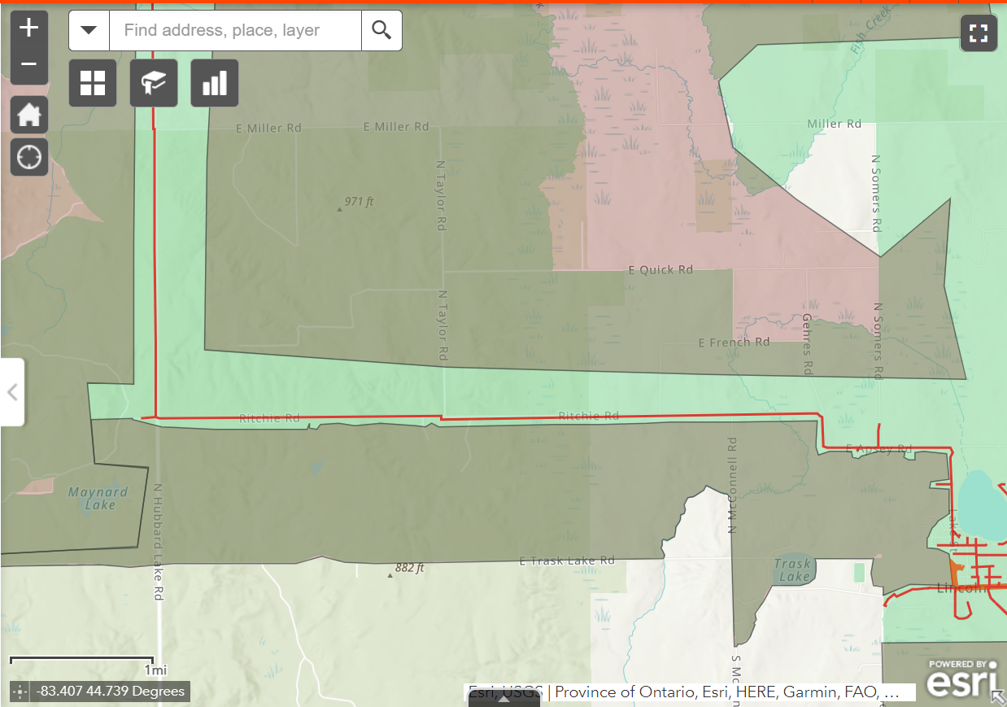
PROJECT OVERVIEW
Alcona County, Michigan
This allows us to trim areas of overstatement and better understand the locations that are served and unserved by broadband.
This map shows coverages areas that need trimmed based on the location of broadband infrastructure in the right-of-way.

Slide 14
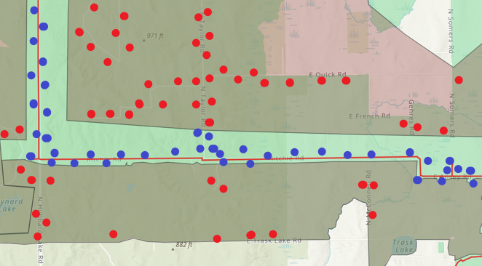
PROJECT OVERVIEW- Sample

Slide 15
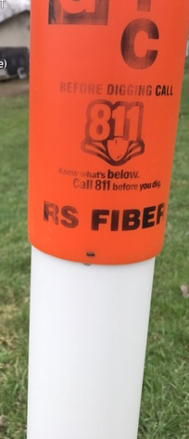
PURPOSE
Identify every location (address) unserved and underserved by broadband in Michigan for the forthcoming BEAD Program.
Gather data in anticipation of challenging the forthcoming FCC broadband map.
Provide the state with a foundation for tracking broadband build-out, grant progress and commitments, etc.
Beyond a better understanding of broadband availability, this project has two short-term and one long-term purpose

Slide 16
Federal Updates – April 2022
RDOF- Point Broadband, Baraga Telephone, Charter, Cherry Capital Connections, High Line Broadband, & Thumb Electric Coop, Midwest EC, Presque Isle EC, Great Lakes Energy, Lake Net and Mercury Broadband have been authorized for funding, still waiting on others.
USDA – ReConnect
• $1.15 Billion- Applications open November 24, 2021- Due February 22, 2022
• Serve an area without broadband service at speeds of 100 megabits per second (Mbps download) and 20 Mbps (upload)

Slide 17
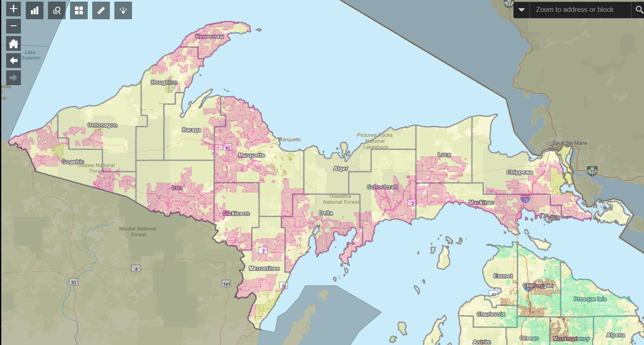
RDOF Map

Slide 18
RDOF Funding -$171 Million
44,873 Locations

Slide 19
ReConnect – Eligible Entities-BEAD(?)
Eligible:
Corporation, Limited Liability Company (LLC) and Limited Liability , Partnership (LLP), Cooperative or mutual organization, States or local governments, including any agency, subdivision, instrumentality, or political subdivision thereof, Territory or possession of the United States, Indian tribe, as defined in section 4 of the Indian Self Determination and Education Assistance Act
Ineligible:
Individuals, Legal partnerships formed with individuals, Co-applicants

Slide 20
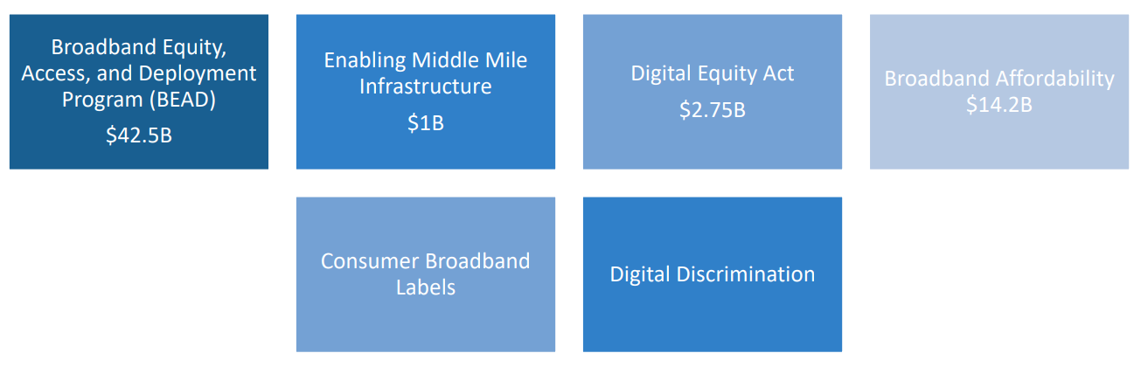
Infrastructure Investment Jobs Act
• $65B for broadband infrastructure and digital equity
• Comprised of four primary funding programs and two policy related efforts

Slide 21
Broadband Equity, Access, and Deployment Program (BEAD)
• $42.5B through formula-based grants to states.
• States will competitively award grants to support infrastructure deployment, mapping, and adoption projects.
• NTIA to issue NOFA in May (15)(?)
• Three discrete categories of funding:
1. $100M Minimum Allotment per state
2. $4.25B High-Cost Funding
3. $32.2B Unserved Funding

Slide 22
Broadband Equity, Access, and Deployment Program (BEAD)
$32.2B Unserved Funding
• Allocation based on new FCC DATA Maps to be published in 2022
• ~$1.5B/1.7B for Michigan - if
• For infrastructure deployment to unserved (25/3) and underserved (100/20) areas –those areas get priority over areas already served (100/10)
• Connecting eligible CAIs that lack gigabit-level broadband
• Data collection, mapping, and planning
• Installing broadband infrastructure or providing reduced-cost services • Broadband adoption programs, including device provision

Slide 23
Broadband Equity, Access, and Deployment Program (BEAD)
Infrastructure subrecipients must:
• Provide 100/20 service with latency sufficient to support real-time applications – scalable technology that can provide 100/100 service
• Must offer at least one low-cost service for low-income subscribers
• Service must be deployed, and service commenced, no later than four years after the date of the subgrant.
• A state or subgrantee must provide at least a 25% match of the project costs. NTIA may waive matching requirements, and it does not apply in high-cost areas

Slide 24
Enabling Middle Mile Infrastructure
$1B competitive grant program for the construction, improvement, or acquisition of middle mile infrastructure
• Wide variety of eligible entities: state, political subdivision of a state, tribal government, technology company, electric utility, utility cooperative, public utility district, telecommunications company, telecommunications cooperative, nonprofit foundation, nonprofit corporation, nonprofit institution, nonprofit association, regional planning counsel, Native entity, or economic development authority.
• Prioritization must be given to connecting middle mile infrastructure to last mile networks that provide or plan to provide broadband service to households in unserved areas, and the offering of wholesale broadband service at reasonable rates on a carrier-neutral basis
• NOFA May 2022- Projects must be completed by 2026.

Slide 25
Digital Equity Act
$2.75B to create two distinct grant programs
• State Digital Equity Capacity Grant Program
• Digital Equity Competitive Grant Program
• Purpose is to promote digital equity, support digital inclusion activities, and promote increased broadband adoption.
• “Digital equity” is the condition in which individuals and communities have the information technology capacity that is needed for full participation in the society and economy of the United States.
• “Digital inclusion” is defined as activities that are necessary to ensure that all individuals in the United States have access to, and the use of, affordable information and communication technologies, such as fixed and wireless broadband internet services and internet-enabled devices

Slide 26
Broadband Affordability
Renames the Emergency Broadband Benefit to the Affordable Connectivity Program and makes it permanent – March 2022
• Allocates $14.2B to sustain the program for 10 years
• Provides a $30 per month subsidy, $20 less than the EBB
• Locations in high-cost areas could receive up to $75 per month if a $30 per month subsidy would create a hardship for the ISP
• Subsidy can be used on any service offering from a participating ISP
• ISPs cannot require credit checks for participation, but can terminate service after 90 days of nonpayment
• ISPs must also carry out public awareness campaigns regarding the program
• FCC to establish rules protecting consumers that enroll in the program and a compliant process
Michigan – 412,000 participating

Slide 27
Consumer Broadband Labels
• Within one year, ISPs must display broadband labels disclosing information on their service plans
• Includes information on cost, data, taxes, rental fees, speed, etc.
• In-line with the FCC’s 2016 Public Notice that was never implemented

Slide 28
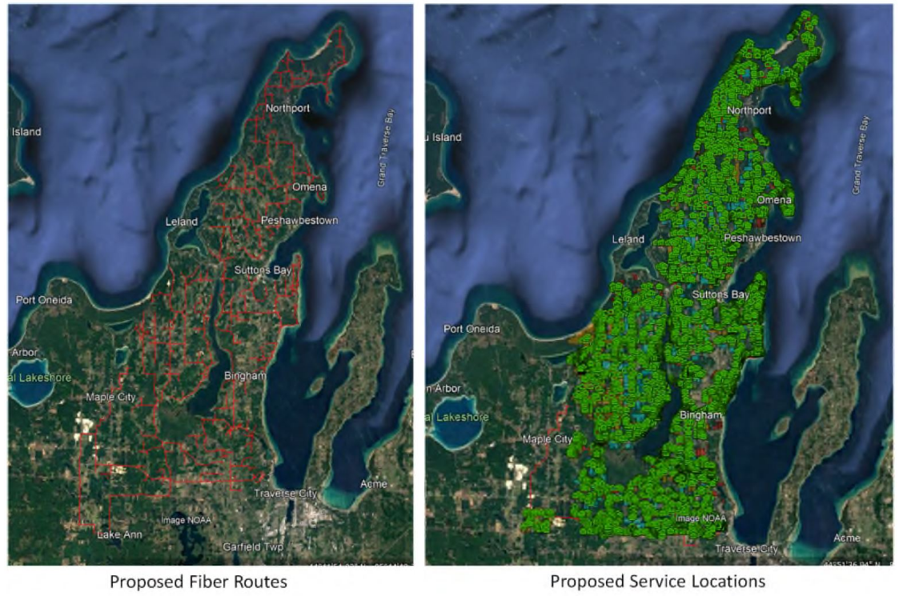
Leelanau/Point/Cherryland EC/Wolverine Power
Leelanau County determined through community engagements that 75% of ARPA Funds were to be used for broadband- $3.2 million with another $1.8 million coming from other local sources for a total contribution of $5 million of the $17.5 million project which will bring gigabit level service to around 10,000 locations of which 5,100 location have no or little service.

Slide 29
Leelanau County Project
Broadband team created and a Technology Plan developed for the county. The community leaders developed a relationship with service providers, creating a stronger understanding of the issues surrounding the expansion of broadband in the county.
Hired a consultant to map unserved and created a broadband expansion plan
Signed NDAs with potential providers and discuss various options
Worked in conjunction with the Coops who would be supplying infrastructure and middle-mile
Selected best option via negotiation and developed a MOU for first phase to bring fiber to over 5,100 unserved
Signing a contract that allows use of $3.2 million ARPA funds

Slide 30

Resources
Information and resources are available at: https://connectednation.org/michigan/
Sign up for the monthly broadband newsletter: https://www.michiganbusiness.org/broadband/
List of Funding:
https://connectednation.org/current-broadband-funding/
https://connectednation.org/michigan/available-broadband-funding-resources/
https://www.fcc.gov/acp-consumer-outreach-toolkit

Slide 31

Questions?
Tom Stephenson
Community Technology Advisor
Connected Nation Michigan
tstephenson@connectmi.org
tstephenson@connectednation.org
(248) 376-4046 mobile

