Slide 1
U.P. Association of County Commissioners
Fall Conference | Oct. 6, 2022
Sarah Szurpicki, Michigan Office of Sixty by 30 Director
U.P. regional attainment goal discussion

Slide 2
Our agenda today:
1
Why 60x30?
Why we believe a postsecondary attainment goal is critical to Michigan’s success
Why do we need regional efforts?
To achieve 60x30, we need state and local efforts to maximize impact
2
3
What do today’s data show about the U.P.?
A data-driven approach helps us identify opportunities for stronger workforce alignment
4
What would it mean to embark on this work?
We can pair state resources and capacity with local expertise and community assets

Slide 3
Why Sixty by 30?
Sixty by 30 seeks to build a competitive Michigan

Slide 4
38% of Michigan families don’t make enough to make ends meet
Why are so many households struggling?
Michigan’s ALICE population is growing
38%
38% of Michigan families
32%
ALICE
19%
25%
45% of UP
families
Poverty
13%
13%
2007
2019
Source: ALICE in Michigan: A Financial Hardship Study, 2021; United Way
Notes:
Most recent Alice Report: https://static1.squarespace.com/static/61802352224f2a00897ee6aa/t/61819452a89b867b55dd0444/1635882070587/2021ALICEReport_MI_FINAL-3-15-21.pdf
45% of families in the UP fall within the ALICE
Add citation to slide
Top 10 states by attainment, per capita income (2022 Q2):
DC -- $98,693
Massachusetts -- $84,365
Colorado -- $73,357
Washington -- $75,099
Minnesota -- $67,026
Virginia -- $67,333
Connecticut -- $84,963
New Jersey -- $78,401
Maryland -- $70,296
Utah – $56,773
Average -- $75,630
Bottom 10 states by attainment, per capita income (2022 Q2):
Nevada -- $60,186
West Virginia -- $48,797
Arkansas -- $51,586
Mississippi -- $45,772
Alabama -- $50,162
Idaho -- $53,304
Oklahoma -- $54,445
Tennessee -- $57,813
Missouri -- $55,801
South Carolina -- $52,796
Average -- $53,066
Michigan -- $56,327
Source: Bureau of Economic Analysis (https://apps.bea.gov/iTable/iTable.cfm?reqid=70&step=1&acrdn=2), Lumina Foundation

Slide 5
Prosperity is not widely shared
Gains have not gone to Michigan’s poorest
Percentage change in Income by Quintile, 1967-2020
Source: U.S. Census Bureau, Current Population Survey, 1968 to 2021 Annual Social and Economic Supplements (CPS ASEC). Table A-4b
Notes:
GRAPH NEEDS UPDATING
-Sarah will take a look
Source: U.S. Census Bureau, Current Population Survey, 1968 to 2021 Annual Social and Economic Supplements (CPS ASEC). Table A-4b
(Note: all numbers are adjusted to 2020 inflation)
First percentile -- $10,870 → $14,589 (34.2% increase)
Second percentile -- $30,120 → $39,479 (31.1% increase)
Third percentile -- $48,091 → $67,846 (41.1% increase)
Fourth percentile -- $67,286 → $109,732 (63.1% increase)
Fifth percentile -- $121,089 → $253,484 (109.3% increase)

Slide 6
Key Economic Performance
Factor | Rank in U.S.
Labor Force Participation | 41st (60.1% in August 2022)
Unemployment | 38th (4.1% in August 2022)
Per Capita Income | 31st ($63,829 in 2020)
Notes:
Unemployment august 2022 from BLS

Slide 7
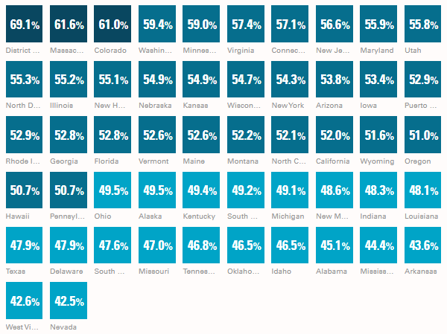
Trailing behind in postsecondary attainment
Where does Michigan stack up nationally?
State-by-State Attainment Comparisons
Source: Lumina Foundation
Notes:
As of today, attainment reported by Lumina Foundation has Michigan at 49.1%.
A modest climb from the 45% we started at when the Governor announced the goal – but we are still lagging when compared to the national average, and behind our neighboring Midwest states.
In order to meet that statewide goal, we must accelerate our progress.
Together with Governor Whitmer and our colleagues in the legislature, we’re working to put a college degree or skills certificate within reach for more adults.
Everyone in Michigan has a right to an educational path to success - whether that is a certificate in the skilled trades, an apprenticeship, an associate degree, or a bachelor’s degree.

Slide 8
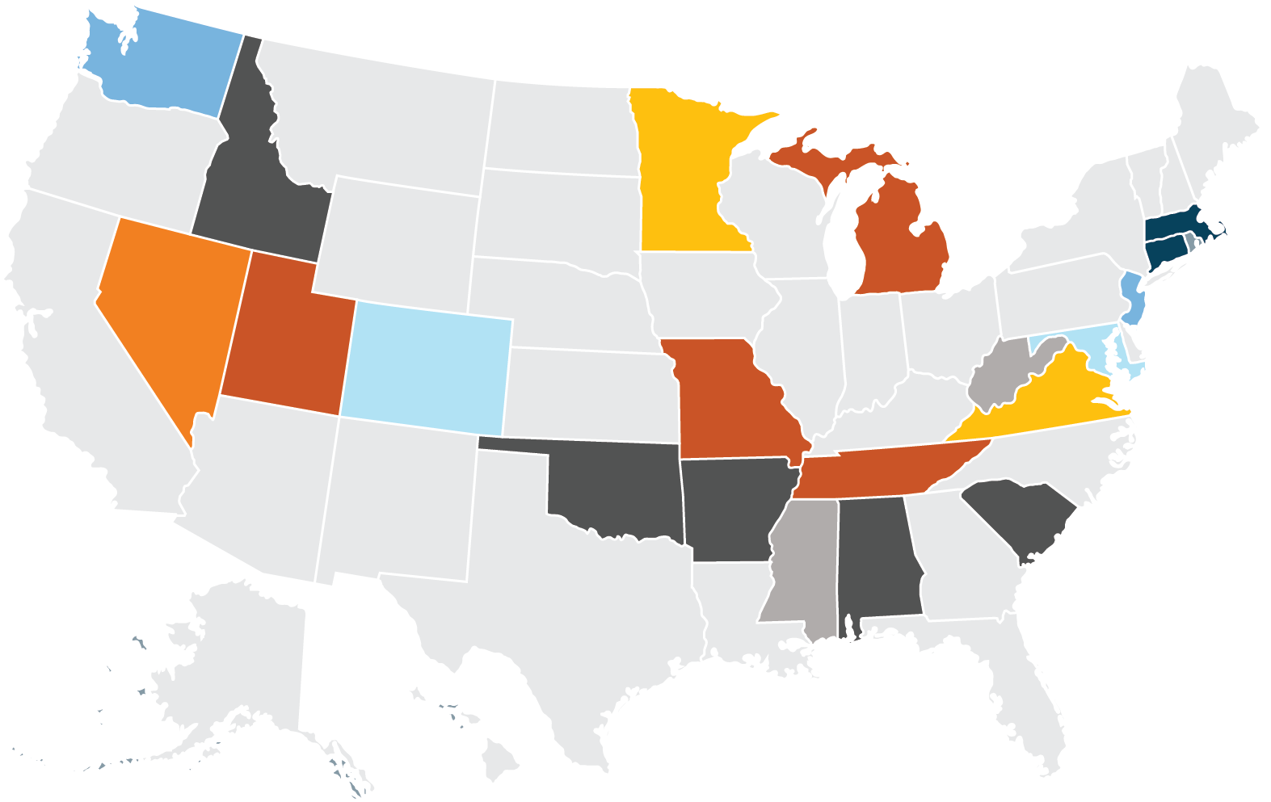
Trailing behind in per capita income
Top 10 states by attainment, per capita income
Average $75,630
Per capita income (2022 Q2)
Michigan per capita income
$56,327
>$80K
$75K-$80K
$70K-$75K
$65K-$70K
$60K-$65K
$55K-$60K
$50K-$55K
<$50K
Bottom 10 states by attainment, per capita income
Average $53,066
Source: Bureau of Economic Analysis (https://apps.bea.gov/iTable/iTable.cfm?reqid=70&step=1&acrdn=2), Lumina Foundation
Notes:
Top 10 states by attainment, per capita income (2022 Q2):
DC -- $98,693
Massachusetts -- $84,365
Colorado -- $73,357
Washington -- $75,099
Minnesota -- $67,026
Virginia -- $67,333
Connecticut -- $84,963
New Jersey -- $78,401
Maryland -- $70,296
Utah – $56,773
Average -- $75,630
Bottom 10 states by attainment, per capita income (2022 Q2):
Nevada -- $60,186
West Virginia -- $48,797
Arkansas -- $51,586
Mississippi -- $45,772
Alabama -- $50,162
Idaho -- $53,304
Oklahoma -- $54,445
Tennessee -- $57,813
Missouri -- $55,801
South Carolina -- $52,796
Average -- $53,066
Michigan -- $56,327
Source: Bureau of Economic Analysis (https://apps.bea.gov/iTable/iTable.cfm?reqid=70&step=1&acrdn=2), Lumina Foundation

Slide 9
Postsecondary education is correlated with lower poverty rates in Michigan
Source: American Community Survey, 2020 5-Year Estimates, U.S. Census Bureau
Notes:
After seeing those slides, you are not surprised then that educational attainment levels are also associated with poverty levels. The more education you have, the less likely it is you are living in poverty.
RM note: unfortunately, can't disaggregate SCND from Associate's Degree with ACS data. The only categories are the four listed.

Slide 10
Median annual wages increase with higher educational attainment.
Source: MiSchoolData, 2020
Notes:
The positives don’t end there – higher credentials are associated higher wages too. University graduates earn more than twice as much as high school graduates.

Slide 11
Postsecondary education is a key strategy to address our workforce challenges
Source: Current Population Survey, 12-Month DEMECON May 2020-April 2021; U.S. Census Bureau
Notes:
Ok, you may be saying to yourself, these stats are interesting, but why should we care so much about educational attainment? It’s because the data is very clear – higher education levels are associated with better economic outcomes. The more education you have, the more likely you are to have to be in the labor force. Not only, are you more likely to be in the labor force, but you are more likely to have a job.

Slide 12
Top Occupations by Education and Training
Notes:
Across each region, we looked at the top jobs for each to see the education and training requirements, for the top jobs in that region. This shows the distribution of education levels needed for the top 50 occupations for each region. When looking at the most highly ranked occupations in each region they tend to require higher levels of education and training. For example, looking at the percentage of top jobs requiring a BA or higher varies from 50% in the east region to nearly 80% in the southeast.
WHEN ARE THESE PROJECTIONS FROM?

Slide 13
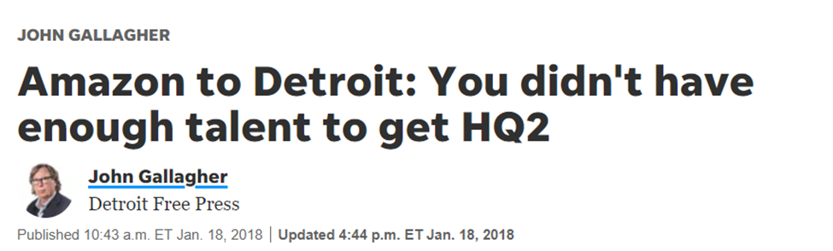
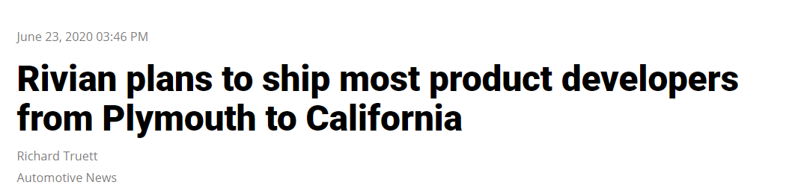
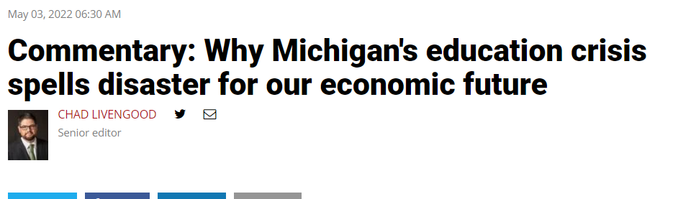
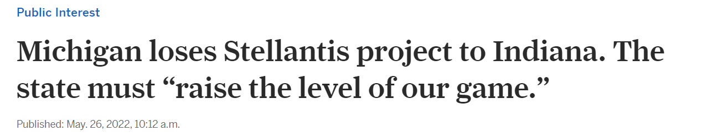
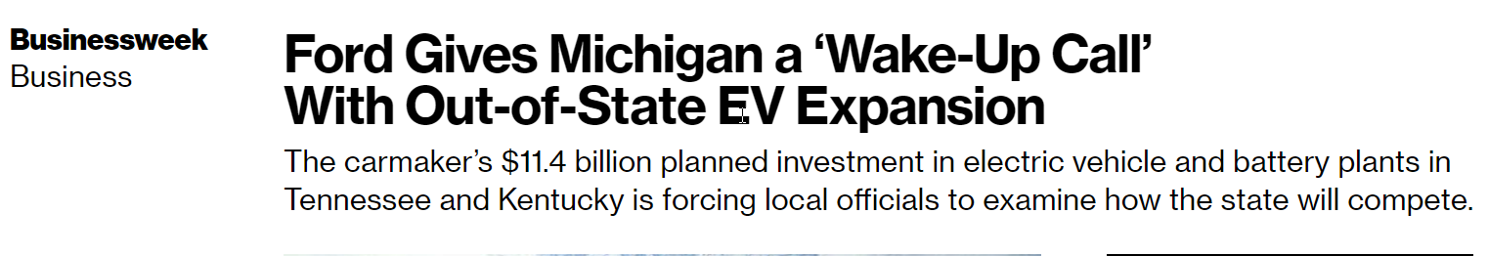
Too many missed opportunities
Rivian CEO RJ Scaringe "believes California is a cool place to be and Detroit has an old technology image," a former Rivian executive told Automotive News. "He thinks California represents tomorrow and Detroit is all about yesterday."
By "talent" Amazon meant a host of issues, from the quality of K-12 education in the region to the brain drain Michigan suffers by losing highly educated, tech-savvy graduates who move elsewhere once they graduate from schools here.
Michigan's education system, which ranks 41st in the nation in high school graduation rates
1 million Michigan adults over age 25 who went to college but never completed a degree, 700,000 of whom live in Southeast Michigan alone
Talent availability and funding to train talent as a factor to move to Indiana
11,000 jobs going to Kentucky and Tennessee
Noted within a 45-minute drive there are 400,000 individuals with the talent the new facilities would need to fill jobs
Noted high industrial power costs, lack of incentives, transportation, skilled labor shortage
Notes:
Narrative slide that includes some narrative
Companies that we missed out on because of talent shortage
Amazon HQ2

Slide 14
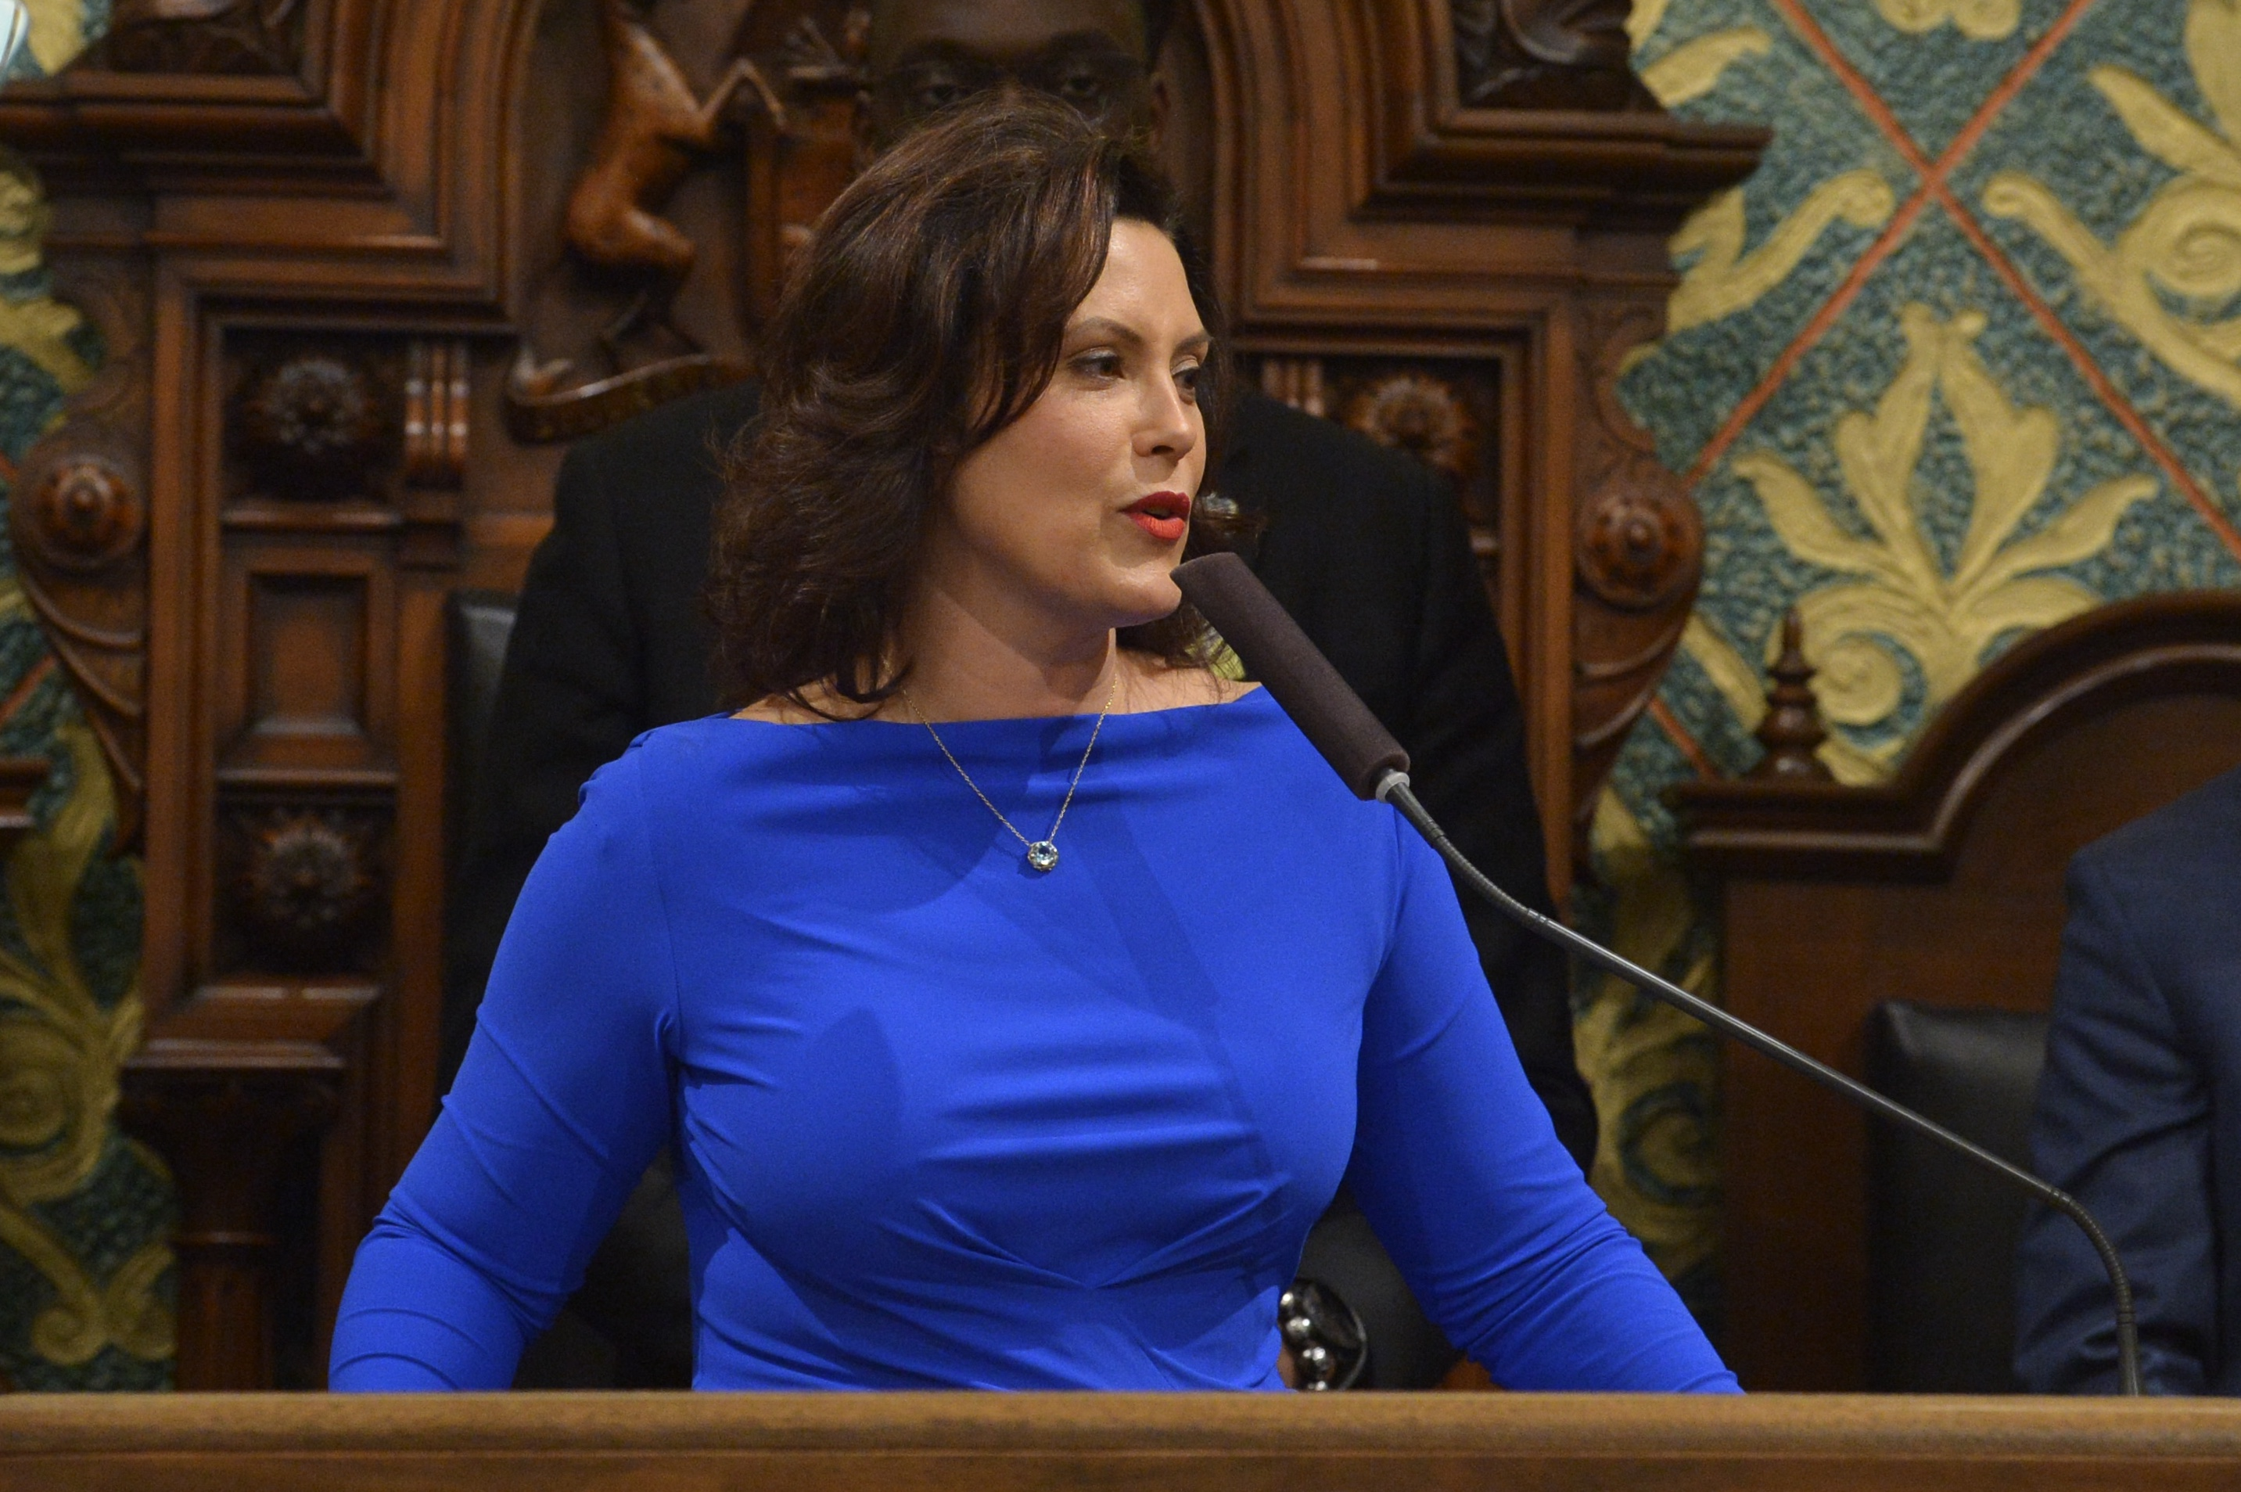
We needed a new ambition
Sixty by 30 is about bolstering the state’s competitiveness and expanding economic opportunity
“I am announcing a new statewide goal of increasing the number of Michiganders between the ages of 25 and 64 with a postsecondary credential to 60 percent by 2030. It’s aggressive. But great expectations lead to great results.”

Slide 15
Sixty by 30 seeks to build a better Michigan
Increasing prosperity
For families
For business
For communities
Sixtyby30.org
Notes:
Sixty by 30 seeks to build a better Michigan in three ways:
Close the skills gap that poses the single greatest threat to the success of our businesses and our state’s prosperity. Jobs requiring skilled employees today, as well as jobs on the horizon, demand greater education and training than ever before. Increasingly, the best jobs require more than a high school diploma.
Increase opportunity and access to the education and skills that create opportunities for better jobs and bigger paychecks.
Make Michigan more competitive for inclusive economic growth.
We are laser-focused on building a healthy and more competitive economy in our state so all hardworking Michiganders can have opportunities for long-term success.
In doing so, we will also bring Michigan closer to helping businesses fill critical talent needs by ensuring Michiganders are put on a path to earn postsecondary credentials needed to fill high-demand, high-wage jobs.

Slide 16


Major Talent Investments
Michigan Achievement Scholarship
Going PRO Talent Fund
Short-term training
Apprenticeship expansion
Notes:
So, how do we get there?
With a focus on our state’s economic competitiveness and prosperity, we know that Sixty by 30 isn't just about credentials..
It's about getting people on a path to rewarding, high-wage, high-demand careers.
Earning a degree of skills certificate beyond high school is the first step when it comes to building a healthy and more competitive economy in our state.
And it's the first step for Michganders to have the tools and opportunities they need for a better job and bigger paychecks.
Through our Sixty by 30 programs, we will close the skills gap, increase economic opportunity, and fundamentally change the state’s economic competitiveness.

Slide 17
Expanding Access to Community Colleges
120,000+ applications
Demographics (self-reported):
  67% women
26,000+ enrolled
1,500+ credentials earned
101,000+ applications
Demographics (self-reported):
  66% women
  56% are between 25-34
18,000+ enrolled
500+ credentials earned
Notes:
• AI/NA/H/PI 1% • Asian 1% • Black/African American 32% • Hispanic/Latinx 4% • White/Caucasian 51% • Two or More Races 5% • Other/Prefer Not to Answer 5%
Data note:
The credential data is quite behind - I think the most recent credentials in the CRM were earned in December 2021. The applicant data we receive weekly - so the total number of demographic breakdown gets updated more recently. The enrollment data is also slightly behind, that's reflective of first-time participants who started in Summer 2021, Fall 2021, and some of Winter/Spring 2022. Still need to upload and analyze the rest of Winter/Spring 2022 and Summer 2022.

Slide 18
Investing in Navigators
Investing in student needs
Wrap around grants provide additional support that prevent students from stopping out.
The path to enrolling and graduating from college can be challenging.
Hired 10 Reconnect Navigators
Navigators assist in college enrollment and participation Reconnect
All applicants are automatically assigned to a Navigator.
Invested $430,000 into MCAN College Completion Corps
$6 million granted to 31 institutions
Starting as early as Fall 2022, eligible Frontliners and Reconnectors can receive up to $550 an academic year towards basic needs, including, but not limited to:
  Childcare
  Transportation
  Housing
  Broadband services
  Book, course fees, and out-of-district tuition if needed
Notes:
The path to enrolling and graduating from college can be challenging.
To help meet our goal and provide students with the critical support they need to successfully enroll in classes and complete a skill certificate or associate degree program, we hired ten Navigators
and invested $430,000 into the Michigan College Access Network (MCAN) College Completion Corps to support Michigan's adult students.
Navigators offer Michigan Reconnect applicants, who are first-time students or have been out of school for some time, a network of support and guided assistance while they take the required steps to successfully enroll in college and participate in the Michigan Reconnect scholarship program.
These outreach and support professionals are critical investments in helping applicants every step of the way to successfully complete a certificate or degree program.

Slide 19
Why do we need regional goals?
Local assets and leadership needed to maximize impact
Notes:
Why the regional strategy is important

Slide 20
400,000
Credentials beyond the trend line

Slide 21
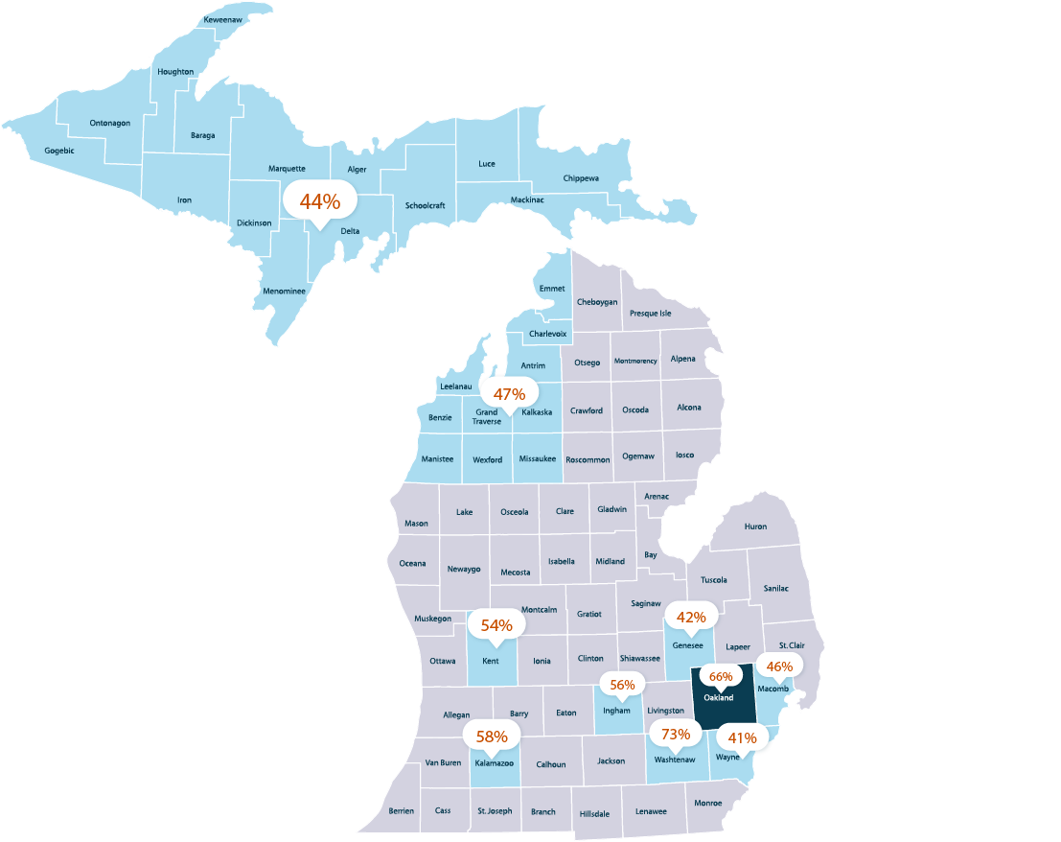
The impact of 10% growth:
+362,631 additional credentials
Notes:
This is based on the idea of moving these counties to 10%+

Slide 22
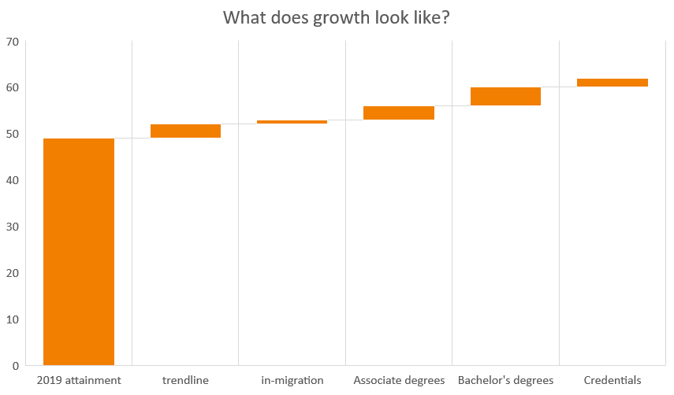
Achieving Our Goal
Notes:
Boost college enrollment rates – among traditional aged students right out of high school AND working-aged adults.
Dramatically improve credential completion rates, particularly among community colleges.
Keep our talent here in Michigan – ensuring those that graduate from our institutions stay here in Michigan.
Attract educated workers in Michigan to fill our most in-demand jobs.
But – I think we can say that we must….

Slide 23
Why set a public goal?
Setting a public goal has tangible benefits
State a vision
Define how education is part of the Upper Peninsula’s unique culture
Be a leader in rural innovations in achieving prosperity
Generate tangible momentum by…
Driving collaboration and scale
Marketing around existing programs
Marketing the region and goal – a vision for the future
Influencing / Creating a culture of postsecondary attainment
Standardizing best practices between institutions
Creating (and maintaining) a coalition
Aligning existing efforts / resources (including philanthropic funding and efforts led by community-based organizations)

Slide 24
Data informed modeling
Map strategies in progress
Review current data
Projected industry and occupation growth
Set 2030 outcomes
Identify areas for growth

Slide 25
What do today’s data show about the U.P.?
Getting started on a data-driven strategy
Notes:
Why the regional strategy is important

Slide 26

U.P.-wide rate: 44%
Rank
County
Credential+ %
Population 25-64
Above state rate
12
Keweenaw
52.4%
957
13
Marquette
52.3%
31,826
15
Houghton
51.6%
14,933
Below state rate
17
Dickinson
48.2%
12,847
23
Delta
45.4%
17,788
36
Gogebic
40.4%
7,432
45
Mackinac
38.7%
5,394
49
Ontonagon
36.9%
2,701
50
Chippewa
36.6%
19,332
53
Menominee
35.9%
11,492
56
Luce
35.6%
3,493
59
Iron
35.0%
5,284
66
Baraga
33.9%
4,314
69
Schoolcraft
33.7%
4,008
79
Alger
30.4%
4,709
Statewide rate
49.1%
This Photo by Unknown Author is licensed under CC BY-SA-NC
Notes:
Quartiles:
First: Keweenaw, Marquette, Houghton, Dickinson
Second: Delta, Gogebic
Third: Mackinac, Ontonagon, Chippewa, Menominee, Luce, Iron
Fourth: Baraga, Schoolcraft, Alger
Population 25-64:
Keweenaw – 957
Marquette – 31,826
Houghton – 14,933
Dickinson – 12,847
Delta – 17,788
Gogebic – 7,432
Mackinac – 5,394
Ontonagon – 2,701
Chippewa – 19,332
Menominee – 11,492
Luce – 3,493
Iron – 5,284
Baraga – 4,314
Schoolcraft – 4,008
Alger – 4,709

Slide 27
Share of Population Ages 25-64 by Educational Attainment in the U.P.
Source: 2020 5-Year ACS Estimates
Notes:
Source: 2020 5-Year ACS Estimates for Alger, Baraga, Chippewa, Delta, Dickinson, Gogebic, Houghton, Iron, Keweenaw, Luce, Mackinac, Marquette, Menominee, Ontonagon, and Schoolcraft counties.
Less than HS: 8857
HS grad or equivalent: 47,566
SCND: 24,409
Certificate/Credential: 10,842
Associate's degree: 17,881
Bachelor's degree: 25,785
Grad/prof degree: 11,170
Re-do either a pie or stacked bar chart

Slide 28
Educational Attainment by Gender (Population 25 Years and Older) in the Upper Peninsula
Notes:
Source: 2020 5-Year ACS Estimates for Alger, Baraga, Chippewa, Delta, Dickinson, Gogebic, Houghton, Iron, Keweenaw, Luce, Mackinac, Marquette, Menominee, Ontonagon, and Schoolcraft counties.
Note from RM: first category can't disaggregate between HS diploma and less

Slide 29
Share of Population 25 Years and Older with a Bachelor’s Degree or Higher by Race and Ethnicity and Gender, in the Upper Peninsula
Notes:
Note: the data that LMI provided in their similar slide are only available with 1-year estimates; this is the closest alternative with 5-year data.
Note to RM: fix axes
Source: 2020 5-Year ACS Estimates for Alger, Baraga, Chippewa, Delta, Dickinson, Gogebic, Houghton, Iron, Keweenaw, Luce, Mackinac, Marquette, Menominee, Ontonagon, and Schoolcraft counties.

Slide 30
Median annual wages increase with higher educational attainment.
Source: ACS 2020 5-year estimates
Notes:
Less than HS diploma: $18,685 for UP, $23,129 for Michigan
HS diploma: $26,603 for UP, $30,900 for Michigan
SCND/Associate's Degree: $31,793 for UP, $36,313 for Michigan
Bachelor's Degree: $44,358 for UP, $54,452 for Michigan
Grad/professional degree: $54,423 for UP, $72,730 for Michigan

Slide 31
Number of Individuals Employed with Some College and Above by Supersector in the Upper Peninsula
Source: Longitudinal Employer-Household Dynamics (LEHD), Third Quarter 2021, U.S. Census Bureau, Michigan Bureau of Labor Market Information and Strategic Initiatives, Department of Technology, Management, and Budget

Slide 32
Share of Employment at each Educational Level by Industry Supersector in the Upper Peninsula
Source: Longitudinal Employer-Household Dynamics (LEHD), Third Quarter 2021, U.S. Census Bureau, Michigan Bureau of Labor Market Information and Strategic Initiatives, Department of Technology, Management, and Budget

Slide 33
Top Occupations by Projected Growth (2018–2028) and Typical Education in the Upper Peninsula
POSTSECONDARY NONDEGREE AWARD OR MODERATE-TERM TRAINING
OCCUPATION | PROJECTED EMPLOYMENT GROWTH | PROJECTED AVERAGE ANNUAL OPENINGS
Cement Masons and Concrete Finishers | 10 | 10
Medical Assistants | 60 | 70
Medical Secretaries | 10 | 70
Teacher Assistants | 20 | 135
Welders, Cutters, Solderers, and Brazers | 30 | 55
ASSOCIATE DEGREE OR LONG-TERM TRAINING OR APPRENTICESHIP
OCCUPATION | PROJECTED EMPLOYMENT GROWTH | PROJECTED AVERAGE ANNUAL OPENINGS
Carpenters | 20 | 135
Electricians | 30 | 70
Industrial Machinery Mechanics | 30 | 55
Machinists | 60 | 55
Plumbers, Pipefitters, and Steamfitters | 20 | 30
Source: 2018–2028 Upper Peninsula Michigan Occupational Projections, Bureau of Labor Market Information and Strategic Initiatives, Department of Technology, Management, and Budget

Slide 34
Top Occupations by Projected Growth (2018–2028) and Typical Education in the Upper Peninsula
BACHELOR’S DEGREE OR HIGHER
OCCUPATION | PROJECTED EMPLOYMENT GROWTH | PROJECTED AVERAGE ANNUAL OPENINGS
Financial Managers | 40 | 30
Industrial Engineers | 30 | 25
Market Research Analysts and Marketing Specialists | 70 | 45
Mechanical Engineers | 30 | 25
Registered Nurses | 40 | 155
Source: 2018–2028 Upper Peninsula Michigan Occupational Projections, Bureau of Labor Market Information and Strategic Initiatives, Department of Technology, Management, and Budget

Slide 35
Frontliners and Reconnectors in the Upper Peninsula
~1,540 applications from U.P. counties
~500 enrolled at UP community and tribal colleges
~1,150 applications from U.P. counties
~275 enrolled at U.P. community and tribal colleges

Slide 36
What would it mean to embark on this work?
How we imagine the work continuing

Slide 37
Our strategy
Step 1: Identify champions who build a leadership table and drive setting a goal locally
Step 2: Work with the leadership table to review data, set goal, and build larger stakeholder engagement
  Use labor market data to create path to success
  Map existing community strategies and identify areas for growth
  Help articulate the need for new and scaled up strategies
  Public articulation of goal
Step 3: Identify an owner – the entity(ies) that will keep the work moving forward—and infrastructure to continue momentum
  Continual partnership to grow best practices, align resources, leverage peer learning, and support policy development

Slide 38
The UP can set a goal to improve economic competitiveness and grow family prosperity
47% goal
54% goal
If every UP county stays on current attainment trend (based on last 10 years of growth)
No net incremental degrees / credentials
relative to current attainment trends
The UP must implement local credential strategies; double down on non-traditional age success outcomes
~9,000 net incremental degrees / credentials relative to current attainment trend

Slide 39
Traditional age students
Baseline data
college enrollment rate within 6 months
# students in grade
6-12
# of undergrad students enrolled in UP public universities
  53%
20,998 total
3000 avg.
  14,468
6-yr graduation rates (2014/15 cohort HS grads who graduated from college by 2020/21)
# of students enrolled in UP public community colleges
FAFSA completion rate
  46%
  2885
  58%
Notes:
Currently using 2019/20 data for traditional age and 2020 5-year ACS estimate for non-traditional age
58% FAFSA completion rate (353 of 609 high school seniors)
Add FAFSA Completion

Slide 40
Adults 25+
Baseline data
Community college enrollment
College or university enrollment
Need high school equivalency
  779
2110
  18,357
(pop. 34, 927)
Reconnect uptake rate
Some college no degree
Credential+ %
  0.2%
  35,251
  44%
Notes:
Currently using 2019/20 data for traditional age and 2020 5-year ACS estimate for non-traditional age
Community college enrollment: 779
University enrollment: 2110

Slide 41
A Framework for Mapping Current Strategies we’ll work together to map strategies in your region
 | Value messaging | Access/opportunity | Success | Prosperity
 | Establish a culture that values postsecondary education | Create opportunities for accessible postsecondary education | Foster an environment for residents to complete postsecondary education | Dissolve the skills gap so employers have the skilled talent need for a prosperous community
Traditional aged students
Adults 25+
Equity strategies

Slide 42
There are strategies with demonstrated success
Gov, K-12, higher ed, private sector, community-based and philanthropic institutions all have a role
K-12 education
Higher education
Employers and CBOs
Increase FAFSA enrollment
Early middle college
CTE / Credentials of value
College-ready curriculum
Pre-apprenticeship
Improved remediation
Enrollment navigators
On-campus success coaches
Debt forgiveness programs (e.g., WSU)
Wraparound support (adult targeted)
Basic needs support
Adult friendly systems (e.g., flexible scheduling)
Employer support / recognition
Mentorship programs
Need-based scholarship programs
Tuition assistance
Non-financial assistance (books, transportation, etc.)
Flexible scheduling
Payment of hourly employees for class attendance
Working parent support (e.g., onsite childcare, partnerships with provider partners)
Clear career pathways (e.g., including linked promotions)
Emergency support funding / bridge financing for students
Support college going culture
Proactively engage in defining workforce needs
Support barrier removal to postsecondary success

Slide 43
The state can help
Our Sixty by 30 team can provide strategic and technical support
1
Statewide ecosystem
Reconnect, GoingPRO Talent Fund, and alignment of private / philanthropic efforts
4
Help setting strategy
Bringing best practices from around the state and country
2
Data sharing and technical assistance
“Single source of truth” for transparency around attainment and all relevant inputs
5
Convening and marketing power
Leverage working relationships with stakeholders / partners and helping tell the stories
3
Two-way communication
Streamlined communication channels for establishing good state policies
6
Peer learning
Sharing of best practices, both statewide and nationally
Notes:
UPDATE THIS
ADD THAT THESE REGIONAL GOALS CREATES A BETTER TWO-WAY COMMUNICATION FOR ESTABLISHING GOOD STATE POLICIES

Slide 44
Timeline
(just a sample, not firm)
ANNOUNCE REGIONAL GOAL
CONVENE KEY CHAMPIONS
INVITE COMMUNITY TO COLLABORATE
DEVELOP STRATEGIC INITIATIVES
OUR CONVERSATION TODAY
IDENTIFY OWNER TO CONTINUE MOMENTUM
KEEP GOING!
MAP COMMUNITY ASSETS
Notes:
.

Slide 45
Questions and discussion
Contact Sarah at SzurpickiS@michigan.gov

