Slide 1
Childcare and Homelessness Report
Zosia Eppensteiner, CEO
Community Foundation of Marquette County
Notes:
Thank everyone for the opportunity to speak with them today about the challenges our communities face.
HOUSEKEEPING:
Context for CF work and the report
share process, key findings and recommendations
Share local and regional resources we leveraged throughout the process
Mqt Co next steps
Q&A

Slide 2
Connecting donors with community needs
Building permanent funds for charitable giving
Distributes scholarships and grants
Leading and collaborating with our local partners to address community needs
Notes:
Since 1988, the Community Foundation of Marquette County has dedicated itself to strengthening the community and improving the lives of all people in Marquette County.
We support a wide variety of community needs – everything from education, to the environment and conservation to human services. This happens through our grant cycle and also through specific funds that have been established by our donors.
With the community's generous support, the Foundation's assets have grown to more than $24 million to date. Because of our donors’ generosity, in 2021 alone, we supported local agencies and programs with more than $1 million in grant funding.
CONVERNER!

Slide 3
Building Community by Building Networks
The Real Power Comes in Combining Assets in New and Innovative Ways – Linking and Leveraging
Notes:
Community Foundation of Marquette County was selected as one of the SEF Pilot sites and worked with the technical assistance providers and community partners to advance equitable distribution of ARPA funding,
seeking engagement with the public, particularly historically disinvested and underrepresented populations
identifying existing tables around Marquette County Master Plan 2040 priorities that align with ARPA funds purposes and connecting existing efforts
coordinating locally with entities in Marquette County who are receiving funding
working toward identifying short-, mid-and long-term actions that fully support all workers, families, and businesses in Marquette County
leveraging future state and federal funding to support identified action plans
Understanding and helping address our communities’ needs is in our DNA.
To do this, we focused on building and strengthening existing coalitions around key community issues.

Slide 4
Promote Local Strategies
Engaging public input
Identifying existing tables around Marquette County priorities
Inform and support ARPA investments
Leverage funding
Notes:
As one of five pilot sites for a philanthropic collaborative in Michigan
assess equity gaps, structural, financial, programmatic, and cultural barriers, and the potential to advance equitable distribution of ARPA funds,
especially in community project categories of Child Care and Homelessness.
This report presents initial findings and recommendations to promote local strategies for accessing quality and affordable childcare for Marquette County families and providing much-needed resources for individuals and families without shelter. Grow & Lead and Regionerate offer high-level findings and recommendations to guide the Community Foundation of Marquette County and other investors in (1) delivering programs that broadly serve the entire county with a particular focus on historically underserved groups; and (2) piloting programs that fill demonstrated gaps in the housing and childcare ecosystems.

Slide 5
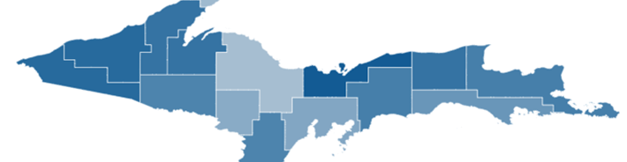
Unique Challenges for Rural Communities
Fewer Choices
Limited transportation options
Lower population density
Fewer skilled service providers
Lower incomes
Notes:
Rural communities in Michigan are spread out much more than micropolitan or metropolitan areas and populations.
have lower incomes and higher rates of unemployment
have fewer employment opportunities
example, compared to urban areas, rural communities have fewer specialized services, shelters, and trained staff to address homelessness.
Limited public transportation, job opportunities, and affordable housing options are additional barriers for rural homelessness

Slide 6
Defining the Needs
KIDS COUNT Data
ALICE Report
Census
UP Childcare Task Force Report (Employers, Parents, Providers)
Public Input
Notes:
Data Annie E casey Foundation
Asset Limited, Income Constrained, Employed
Qs asked: What can be done? What’s impeding the progress?

Slide 7
Notes:
Why Do So Many Households Struggle?
The cost of household basics outpaces wages...
The Household Survival Budget reflects the bare minimum cost to live and work in the modern economy and includes housing, child care, food, transportation, health care, technology (a smartphone plan), and taxes.
It does not include savings for emergencies or future goals like college or retirement. In 2019, household costs were well above the Federal Poverty Level of $12,490 for a single adult and $25,750 for a family of four.
According to the 2020 census, there are 66,017 residents of Marquette County. The United Way’s Asset Limited, Income Constrained, Employed (ALICE) report groups those residents into 27,981 households. The ALICE report found that 13% of those households live at or below the 2019 Federal Poverty Level of $25,750 for a family of four. In addition, it found 21% of Marquette County households to be considered ALICE. These households earned above the Federal Poverty Level but not enough to afford basic household necessities.

Slide 8
Key Findings: Homelessness
Homeless and Rapid Rehousing programs are highly siloed
Programs do not have a quality referral system
The shelters do not have space for families, and temporary housing is in short supply
Physical assets do not meet the demand for housing
Resource providers who serve homeless populations face many complex challenges and are not currently acting as a network of partner providers for a continuum of care
Notes:
Homeless and Rapid Rehousing programs are highly siloed and do not have a quality referral system.
There is a client tracking system that is not updated and is often inaccurate.
The shelters do not have space for families, and temporary housing is in short supply.
Resource providers who serve homeless populations face many complex challenges (mental illness, lack of transportation, food insecurity, unemployment, financial instability) and are not currently acting as a network of partner providers for a continuum of care.
Based on the input of those in attendance, the physical assets do not meet the demand for housing.
At last count, there was no housing available for 22 individuals and 13 families within the 10-county region. There are 400 to 450 calls per month from at-risk persons.
Additional barriers include vouchers with no housing options and unsafe conditions in some of the housing options. The Coalition agreed to research Statewide Housing Plan and funding options for federal and state support, such as MSHDA and HUD.

Slide 9
Recommendations: Homelessness
funding for facility upgrades
more affordable housing stock for renters, transitional housing, and permanent supportive housing options
invest in learning more about the local network resources
consider seeking funding to support a network navigator to ensure transparency of program services
seek out other funding to address common challenges
Notes:
Countywide plan for homelessness and housing
Expansion of land bank program
Nonprofit-led Brownfield projects
Consistent, reliable public transportation
Single source case management with wrap-around services
Incentives for development in outlying townships (contingent on consistent, reliable transportation)
Donations of land to nonprofits and tribal nations working to solve the housing shortage
The subsidized cost of water/sewer for new projects
Investment in KI Sawyer by renovating buildings into housing
Advocacy for capping the number of Airbnbs
If current legislation passes, advocacy for a percentage of tax to go to address housing
Incentives for participating in voucher programs for both landlords and hotels
The Homeless Coalition needs funding for facility upgrades, more affordable housing stock for renters, transitional housing, and permanent supportive housing options. We recommend that they invest in learning more about the local network resources, consider seeking funding to support a network navigator to ensure transparency of program services and seek out other funding to address common challenges.
Based on interviews and working group meetings, the Coalition has the opportunity to become a more cohesive and integrated network of partner providers. One barrier is the quality and timeliness of data about housing opportunities in the shared database. Individuals are forced to go to multiple resources and locations to meet their diverse needs. This team would like to consider how to streamline intake and service delivery for residents, especially those on public assistance and with multiple challenges preventing them from full-time employment and housing stability.
The community and neighborhood-based organizations are often the front doors to government-funded programs (intake, assessment of needs, case management, wrap-around services). Many of these organizations require more staff resources, professional development, and additional funding to do systems work (in addition to their programmatic work).
A potential mitigant to these barriers is hiring a full-time person to be the network navigator. They would proactively identify resources, make them transparent to clients, and help clients access the right resources for their circumstances.

Slide 10
Key Findings: Childcare
A lack of childcare openings impedes many parents from returning to work and causes turnover and difficulty retaining workers
Many childcare workers, especially entry-level, do not earn family-sustaining wages and cannot afford to stay in the profession.
Education providers are experimenting with rapid certifications and skill upgrades
The certification fees for advancement can be a significant barrier for those looking to improve their skills
Many of the existing home care providers are ready to retire without successors
Notes:
A lack of childcare openings impedes many parents from returning to work and causes turnover and difficulty retaining workers.
Many childcare workers, especially entry-level, do not earn family-sustaining wages and cannot afford to stay in the profession.
Many of the existing home care providers are ready to retire without successors.
Education providers are experimenting with rapid certifications and skill upgrades.
The certification fees for advancement can be a significant barrier for those looking to improve their skills.
Common themes included Quality, Affordable Child Care for all ages, including infant care; Livable Wages for Child Care Providers and Workers; Talent Pipeline for Child Care and Early Childhood Education Professionals; Strong Employer Engagement; and Profitable Home-Based Childcare.
The childcare issue has been framed as a low-income and women’s issue. However, interviewees made it clear that it’s an economic development issue. Interviewees cited impacted educated professionals, including teachers, nurses, professors, librarians, and counselors.
According to the 2020 census, there are 66,017 residents of Marquette County. Of these residents, 3,636 are children aged 0-5 (Kids Count). In addition to young children, school-aged children, or children aged 6-12, account for 4,724 residents (Kids Count). This brings the total of children that may need care to 8,360. The Great Start to Quality website shows 1,914 childcare slots in Marquette County. Additionally, 2022 Kids Count data shows that the average cost of full-time childcare per child is $661 per month in Marquette County.
This shortage in childcare has impacted many in the community. Women with low to moderate incomes have been affected significantly. Interviewees that currently have access to care noted how little money from their paycheck is left after paying for rent, food, and childcare. Some interviewees stated they or their partners had chosen to leave the workforce as full-time caregivers. One interviewee shared, “My family decided to be a single-income household, as care cost more money than my partner was making.”
Organizations indicated that as families have additional children, there is a higher chance that a parent will leave the workforce to stay home. "[We] lost a department head because it wasn't financially worth it for her to work after having her second child,” stated one agency. Additionally, there were stories of colleagues relocating out of the area to be closer to family, as that was the only way they could access childcare.
Families with children with challenging behaviors or disabilities experienced more difficulty finding care. As a result, these children were more likely to be asked to leave the center. This would allow the center to bring in a child that was “easier.” An agency that works with children with disabilities shared, “The availability of respite care for caregivers [of children with disabilities] is debilitating."
Finally, organizations that serve women with children experiencing homelessness expressed that lack of care was a barrier to finding employment, which is needed to get into a house.

Slide 11
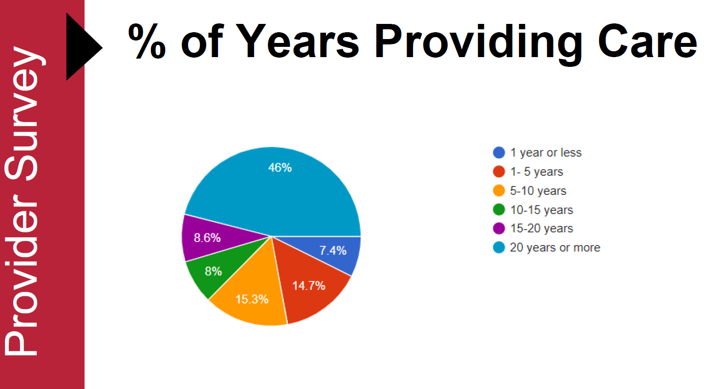
Notes:
Qs asked: What can be done? What’s impeding the progress?

Slide 12
Recommendations: Childcare
Form a new initiative that engages potential home-based childcare providers to participate in a business startup and growth accelerator program
Education and Workforce Development programs should develop the capacity to meet the needs of Marquette County’s current and future industries, including childcare
Innovative business models to support publicly funded and privately run childcare centers
Private and public funding such as Tri-Share, employer scholarships for employees
Engagement of Economic Development Partners and Universities to Support Technology-Enabled Solutions
Notes:
Subsidies for childcare
Options for families and organizations/businesses were mentioned
Higher wages for childcare employees
Expand maternity leave benefits
Reinstate Early Child Care training programs
Create a childcare training center, specifically in partnership with NMU
Incentives and technical assistance for businesses to provide care on site
Waive inspection fees for a childcare center and in-home licensing
Building code and zoning changes to allow for more in-home centers
The CCC's unified vision is to see more family-owned childcare provider businesses thrive. This means inspiring more entrepreneurs to start home-based centers and surrounding them with the experts and resources they need to successfully enter and scale in the market. The CCC developed the concept of providing direct support to cohorts of entrepreneurs and working closely with existing entrepreneur support organizations (ESOs) such as incubators, accelerators, and economic development professionals, as well as child and family service organizations, to raise the collective capacity of the ecosystem to meet their needs. By running focused domain-specific entrepreneur support programming year upon year, the desired outcome is to achieve three high-level objectives:
Support entrepreneur’s representative of underserved communities, with a specific focus on marginalized populations.
Surround these entrepreneurs with the resources they need, a curriculum to build their capacity, and mentors from the community who share their lived experiences.
Strengthen the connective tissues of the community and create a culture of support and pride in local businesses and resilient economies.
Education and Workforce Development programs should develop the capacity to meet the needs of Marquette County’s current and future industries, including childcare. This means helping existing workforce development programs work with the entrepreneurs creating the businesses. These relationships help workforce development programs understand the types of knowledge, skills, and experience that companies will need as they grow and connect the businesses with a diverse talent for hands-on educational experiences that can evolve into careers.

Slide 13
Childcare Business Lab
Business education
Childcare know how
Access to start-up funding
Notes:
The Childcare Coalition proposes to link existing resources at MARESA and Great Start to Quality with Lake Superior Community Partnership to form a new initiative that engages potential home-based childcare providers to participate in a business startup and growth accelerator program.
The cohort-based model has been tested in other regions and serves as a prototype for providing both business education and specialized childcare service supports to ensure Marquette is able to meet the current and future demand for affordable quality childcare.
The program would be sustained by a cost-sharing model with employers and an endowment fund managed by the Community Foundation.

Slide 14
Multiple Funding Sources
Federal Government
State Government
Corporations
Foundations-(family, community, corporate)
Local Organizations (service, public charities, interest groups)

Slide 15
Questions

Slide 16
Thank You!
Community Foundation of Marquette County
PO Box 37
Marquette, MI 49855
ceo@cfofmc.org
cfofmc.org
Notes:
Recognize and thank key partners:
Marquette County and our local municipalities
Great Start to Quality Great Start to Quality - Find High Quality Child Care in Michigan
Lake Superior Community Partnership
Marquette Alger RESA
Grow and Lead
Regionerate LLC

