Slide 1
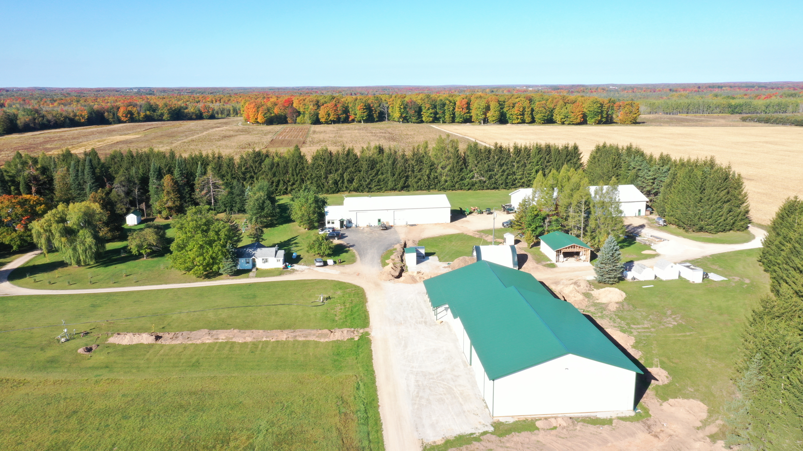
MSU Forestry Innovation Center 8500Acre Research & Demonstration Forest
Jesse Randall
906 -786-1575
randal35@msu.edu
Yooperforestry (youtube)

Slide 2
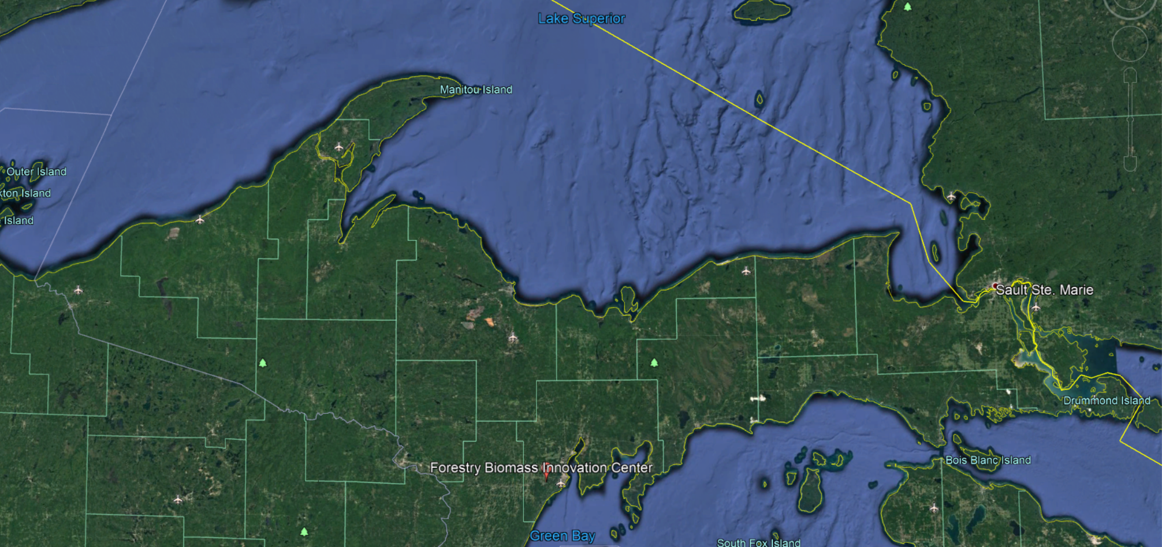
- Since 1986 – Short Rotation Poplar and Willow - 27 researchers @ MSU Dept. of Forestry Bay College – Forestry IAT

Slide 3
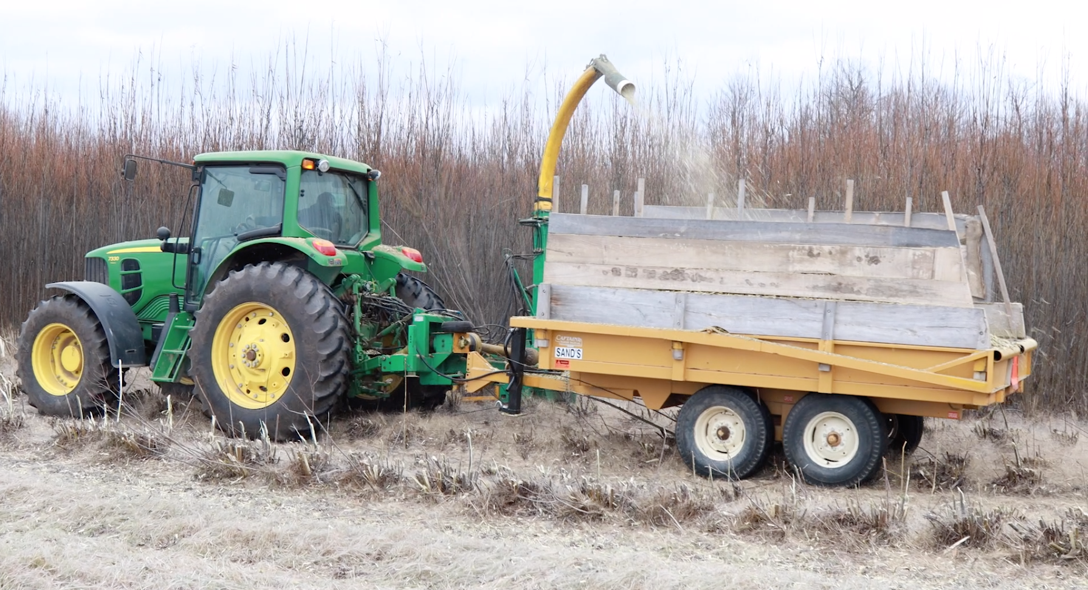
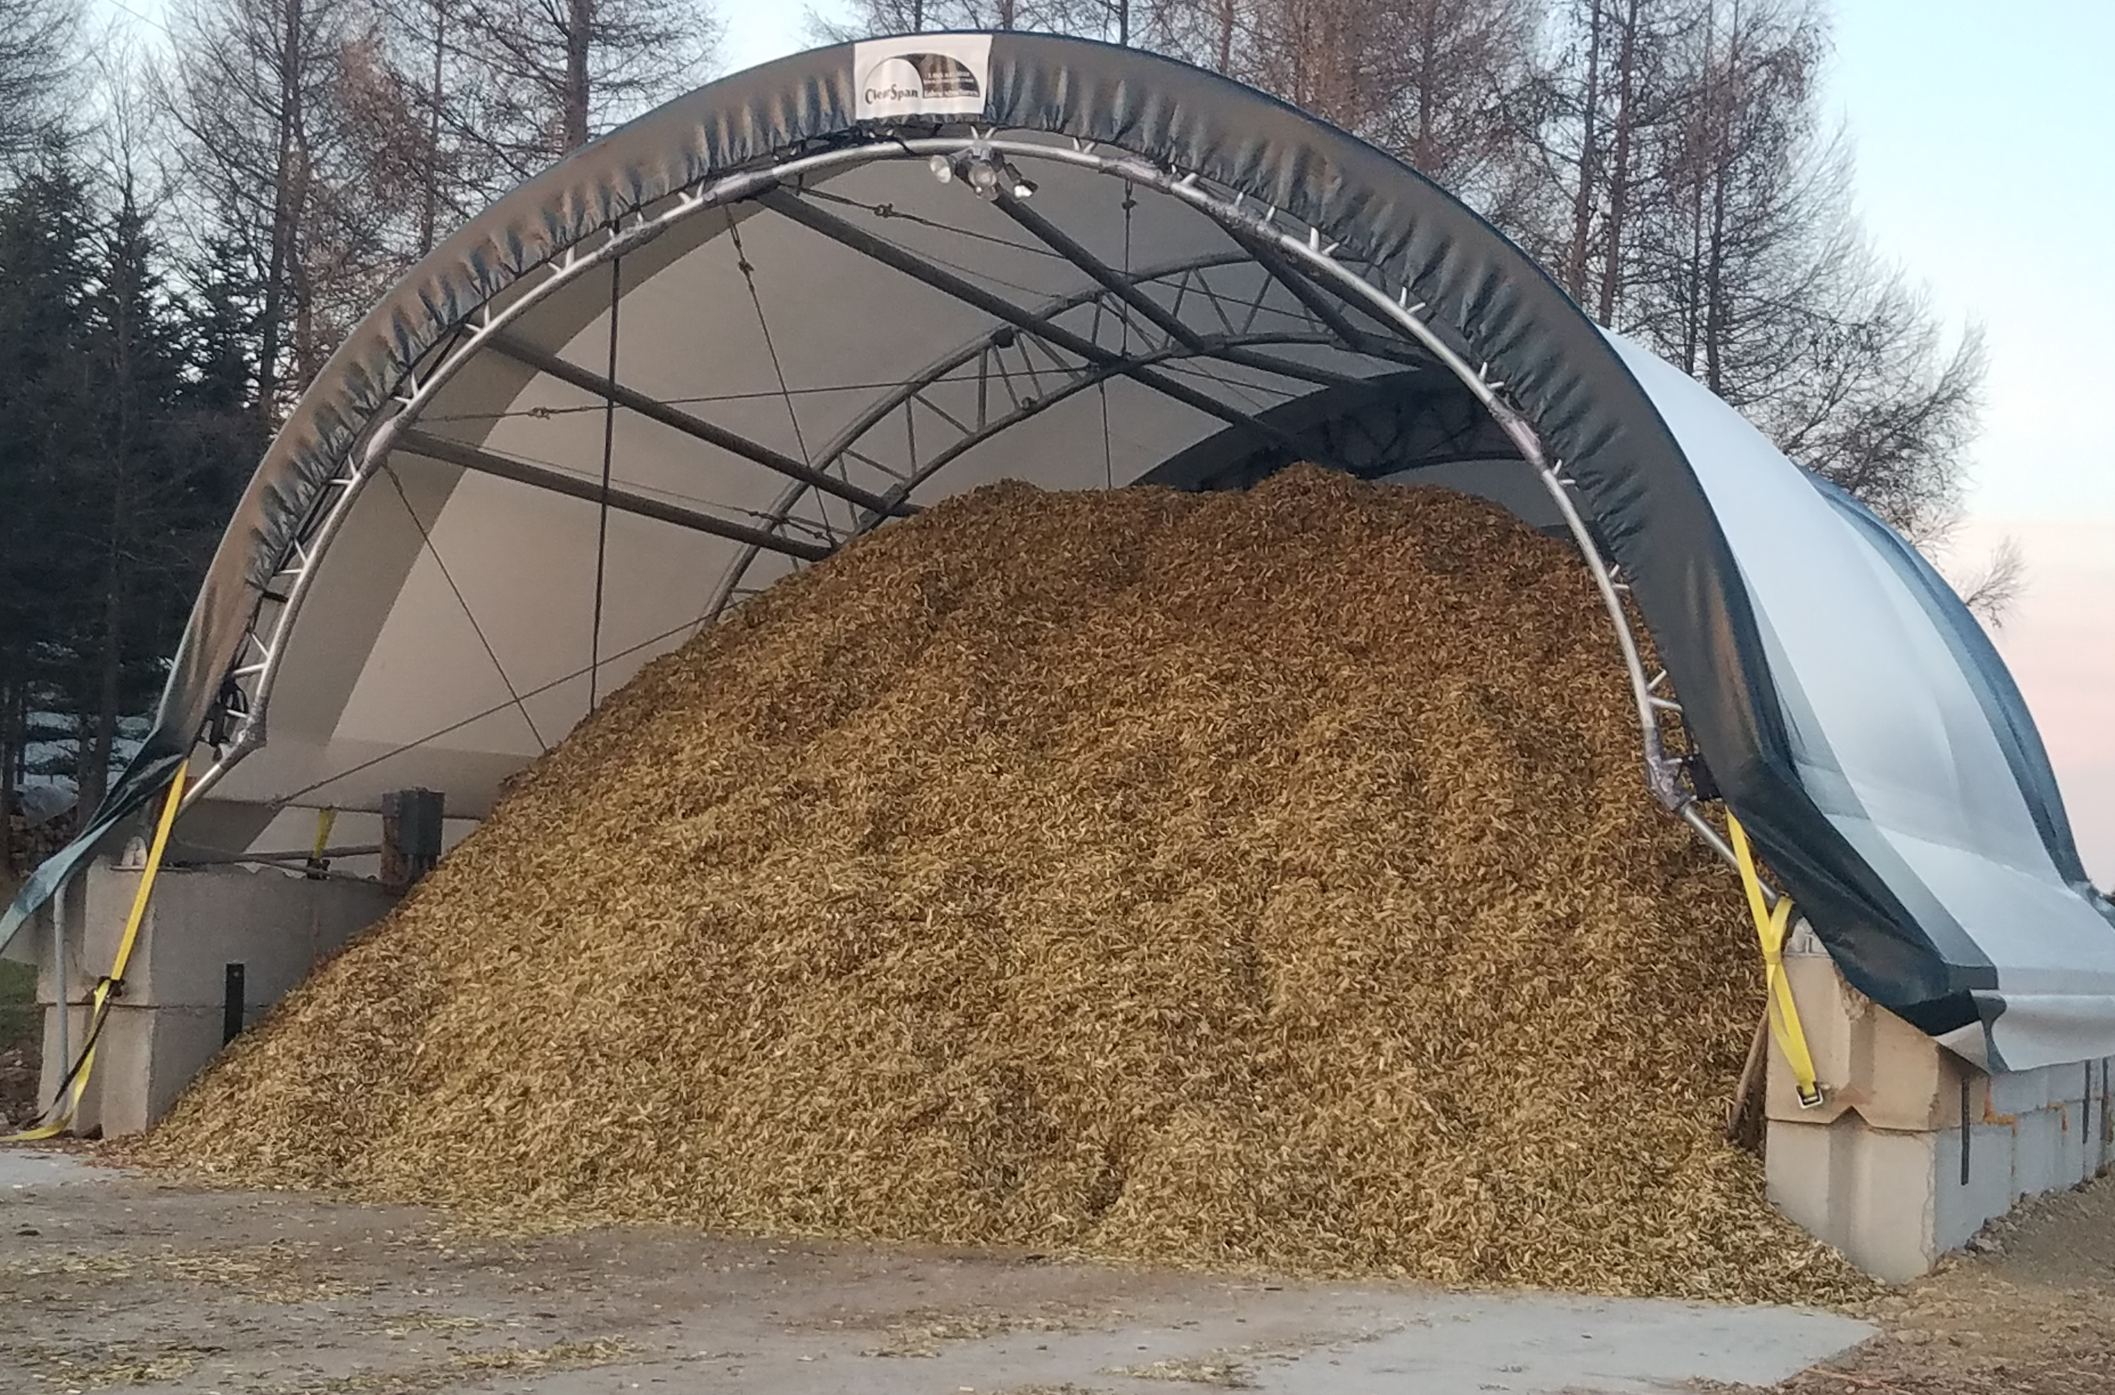
Past History Becomes Opportunity
Expand to operational scales
District heat installation - 2022

Slide 4
District wood chip heat boiler

Slide 5
Education and Outreach
Assist/create Forestry Ag. Tech Degree at Bay
Research to support field days / workshops / trainings
Facilitate research transfer to on-the-ground adoption
SFI in-person training in 2023-2028
Prescribed fire training
Online video content – Yooper Forestry YouTube
Online trainings
SFI Logger Training (MI, GA, MN, MD, DE) – Expanding to ~10 states (5000+ loggers)
Master Woodland Manager – Private Landowners

Slide 6
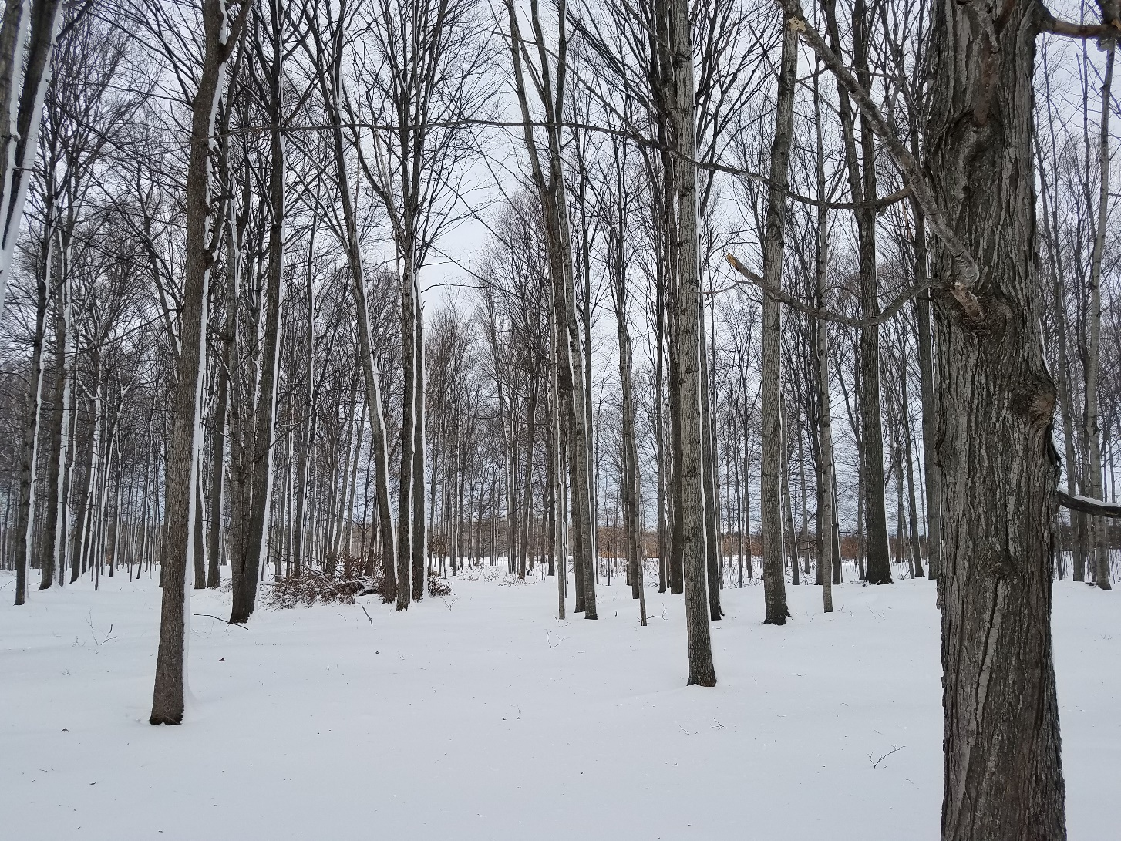
The Future of Midwest Maple Research and Demonstration
3000 taps
Multiple scales of production
Multiple collection layouts
Traditional and Value added product education

Slide 7
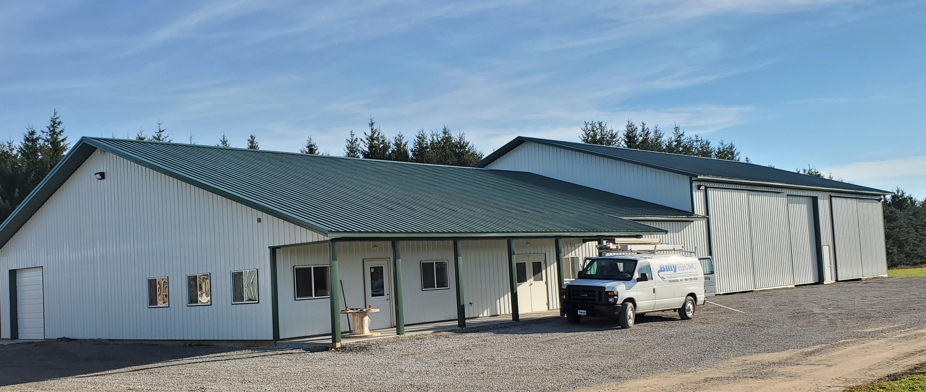
MSU Investment
Working Sugar House
Meeting Space (75)
Confections Lab
Smart Technology

Slide 8
Confections Product Center

Slide 9
4 years of funding - $3.2mil
$500,000 - Biofilm sensor development – Montana State
$500,000 - Concentrated sap use during and post cancer treatment - Northwestern
$499,000 - Tubing sanitation - Montana State
$495,000 - Maple distillation - MSU
$445,000 - Maple manual - MSU
$487,000 – Next generation of maple producers - MSU
$289,000 - Maple education in 5 states - MSU

