Slide 1
U.P. Association of County Commissioners Fall Conference
Strategic Use of Brownfield Incentives
In Your County
Jeff Hawkins, CEO
October 6, 2022

Slide 2
Presentation Outline
Overview
Economic Development = Brownfield Redevelopment
Brownfield Redevelopment Authorities and Land Bank Authorities – A Collaborative Advantage
Project Examples
Wrap up and Q&A

Slide 3
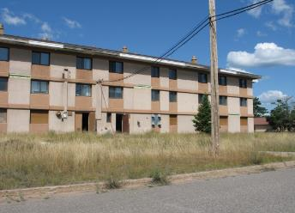
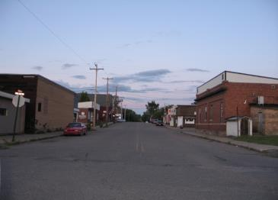
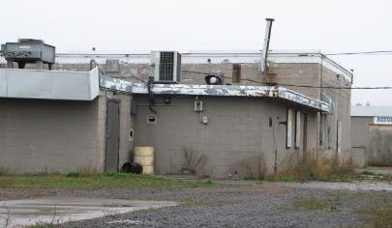
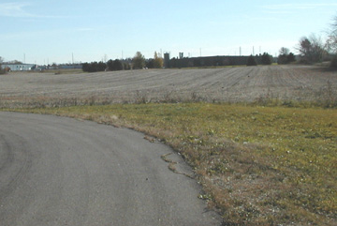
Overview
What do you have to work with?
Notes:
Everyone’s community is different in some way. These differences sometimes require you to approach economic development in ways that fit your community.

Slide 4
Overview
Economic Development vs.(=) Brownfield Redevelopment
  Need to include in the discussion
  Is the resource available in your community?
  “We don’t have any brownfields in our community?”
  How many have an active land bank authority?
    If no county land bank, can use State Land Bank Authority
  Brownfield Redevelopment Authorities and Land Bank Authorities are two of the most powerful local economic development tools available in Michigan.

Slide 5
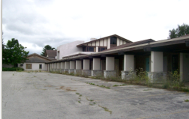
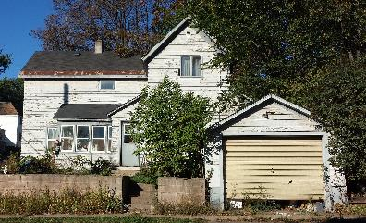
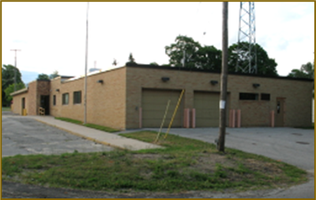
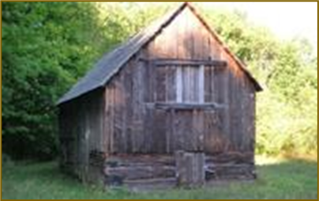
The State of Michigan Definition
Facility:
Contaminated
Blighted: Public nuisance, dangerous, eyesore, or property owned or under control of a Land Bank
Functionally Obsolete:
Can’t be used for its original purpose
Historic Resource:
Historic building or structure
  Other potential properties:
  Tax Reverted Property
  Targeted Redevelopment Area
  Adjacent and Contiguous
  Transit-Oriented Property or Development

Slide 6
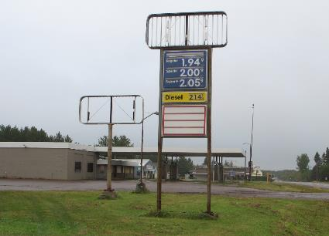
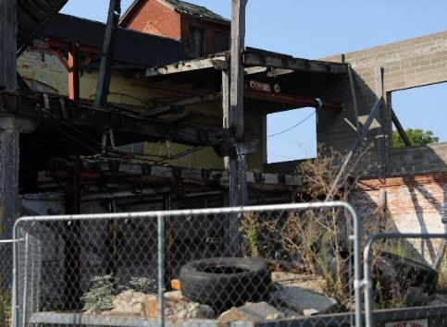
Examples of Brownfields
Landfills and dump sites
Mine-scarred lands
Industrial sites
Commercial facilities
Publicly owned/government buildings
and land
Vacant schools
Former health care facilities
Abandoned and vacant buildings
Dry-cleaning facilities
Gas stations
Railroad yard
Vacant land
Distressed housing
“Main Street” buildings

Slide 7
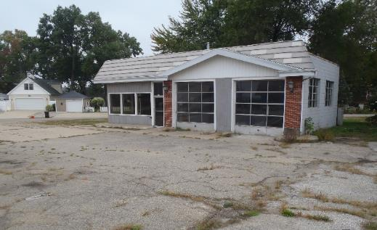
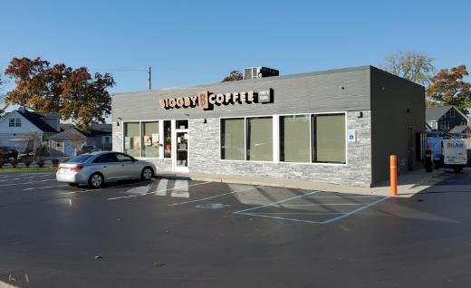
Benefits of Brownfield Redevelopment
Increase investment, jobs, and revenue
Opportunity for focused redevelopment, e.g., workforce housing
Reuse existing infrastructure
Encourage redevelopment
Recovery of tax base
Improve value of surrounding property
Preserve historic and cultural community icons
Conduct environmental cleanup
Reduce sprawl
Before
After

Slide 8
Brownfield Redevelopment Authorities
Established under the Brownfield Redevelopment Financing Act (PA 381 of 1996, as amended)
Broad range of capabilities
Primary use:
  Provide funding/financing of brownfield eligible activities that may create a project financing gap
    Brownfield Plans – Tax increment financing
    Secure and Implement Grants/Loans – EPA, EGLE, LBRF

Slide 9
Land Bank Authorities
Established under the Land Bank Fast Track Act (PA 258 of 2003, as amended)
Broad range of capabilities
Primary use:
  To assist governmental entities in the assembly and clearance of title to property in a coordinated manner that will maximize local policy goals
  To facilitate the use and development of certain property including tax-delinquent, tax-reverted and abandoned properties
  To promote economic growth

Slide 10
Land Banks and Brownfield Redevelopment Authorities
Powerful and uniquely flexible local economic development resources.
Can act as a facilitator to economic development/redevelopment.
Can act as developer/landowner.
Allows projects to move forward that become stalled due to site conditions and/or financing gaps.
Requires patience, innovation, stamina and an open mind.
Strengthens incentives that can attract investment in communities.

Slide 11
Land Bank or Municipal Owned Properties
Brownfield Redevelopment Authority
Private Properties
Brownfield Eligible
BROWNFIELD PLAN (Tax Increment Financing Plan)
Eligible Properties
Contaminated
Blighted
Functionally Obsolete
Historic Resource
Adjacent/Contiguous
Single site or multi-site
Owned by or under control of Land Bank
Eligible Costs
PI/PII ESA’s
BEAs/Due Care
Demolition
Lead/Asbestos/Mold
Core Community or LB
Site Preparation
Infrastructure Improvements
Cleaning or Quieting Title
Selling & Conveying
Acquisition
Reimbursement Schedule
BRA
Developer
Land Bank:
  5/50
  50% BRA
  After 5 years 100% to BRA
Up to 30 years
LBRF
Investment Made
Incremental Taxes Captured
Local
School (optional)
Work with local assessor
Approved by Local Unit of Government and County
For school tax capture potential need for Act 381 Work Plan
Approved by EGLE and/or MEDC/MSF

Slide 12
What are “Eligible Activities”?
(Redevelopment Expenses)
Brownfield Plan
  EGLE Department Specific Activities (Environmental):
  Phase I and II ESAs, BEAs, Due Care activities, response activities, removal and closure of USTs, disposal of solid waste, dust control, specialized foundations, removal and disposal of lake or river sediments, industrial cleaning, certain sheeting or shoring, lead, mold or asbestos abatement
  Demolition that is required to address environmental site issues
  Infrastructure improvements and site preparation for *landfill facilities that meet certain criteria
  MSF Non-Environmental Activities
    Demolition, lead and asbestos abatement
    Site preparation (**Core Communities, Land Bank)
    Public infrastructure (**Core Communities, Land Bank)
  Preparation of Brownfield Plans and Work Plans
  Brownfield Plan and Work Plan implementation
  Administrative costs of the BRA
    *15 or more contiguous acres, location not economically distressed
    **The CORE Communities list currently has 148 qualifying communities
Notes:
Show spreadsheet

Slide 13
Brownfield Plans and Land Banks
Land Bank expands eligible activities (Non-core communities)
  Site Preparation
  Infrastructure Improvements
  Quieting title
  Selling and Conveying
    Marketing the property
    Closing costs
    Seller’s concession = difference between cost of construction and home appraisal or qualified purchaser’s mortgage or rent.
    Legal costs associated with title work, secondary agreements, lending agreements, or other legal agreements associated with home affordability
  Multi-site plans – tax increment shared across sites in plan
    Higher value properties (market rate) can be leveraged to support affordable/attainable housing
  Covering these costs allow rents/sale prices to be lower

Slide 14
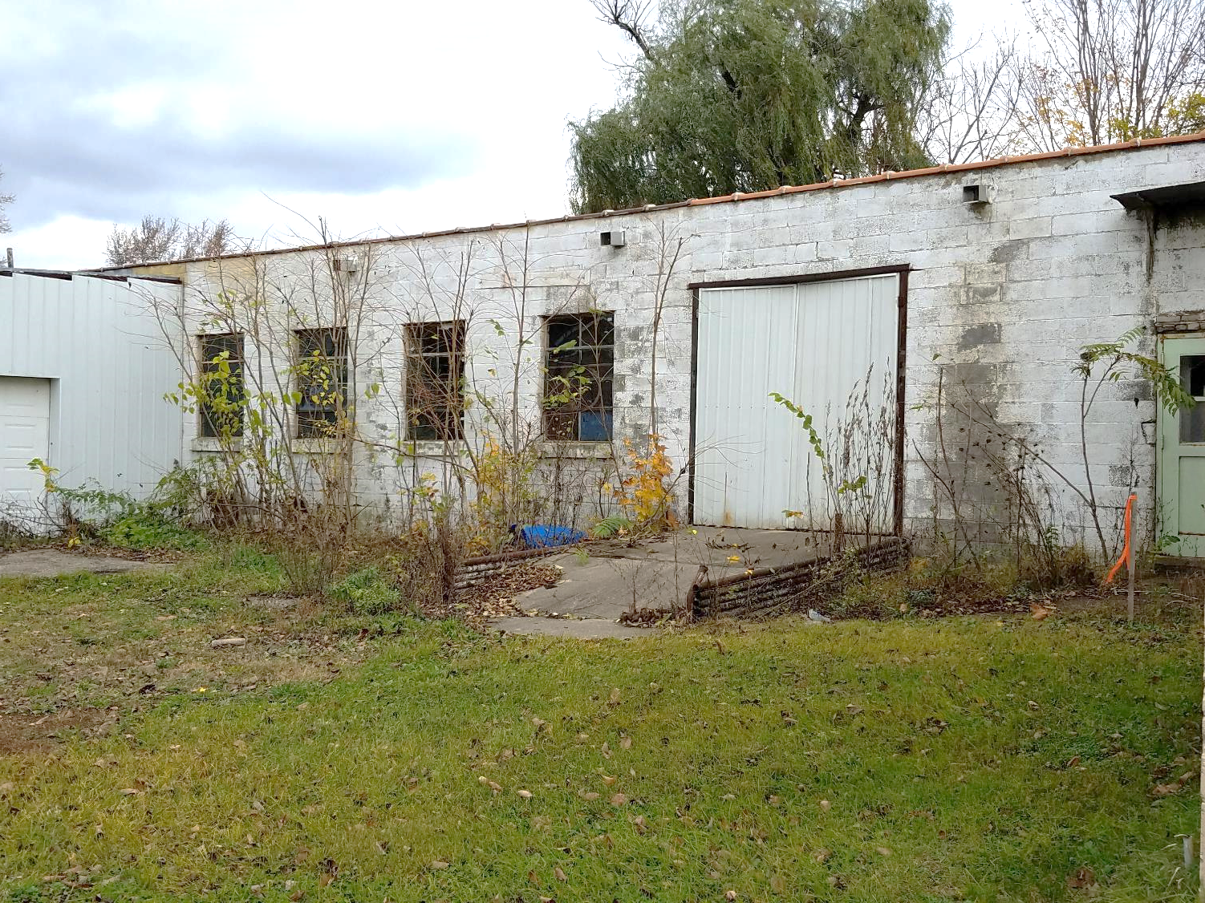
Other Brownfield Redevelopment Funding Tools

Slide 15
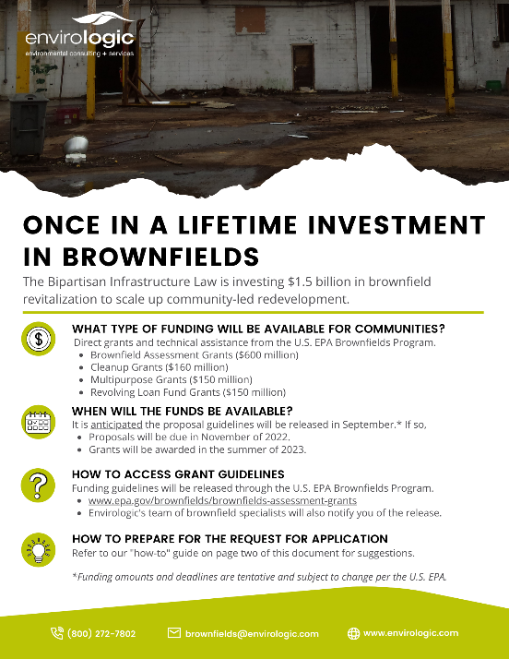
Federal Funding Tools - Infrastructure Law
Bipartisan Infrastructure Law – Includes a historic investment in brownfields
  $1.5 billion investment in the EPA’s Brownfields Program over five years (Approximately $300 million/yr.)
  Brownfield Assessment Grants
  ($600 million) over 5 years
  Cleanup Grants ($160 million)
  Multipurpose Grants ($150 million)
  Revolving Loan Fund Grants
  ($150 million)
Targeted Brownfield Assessments
TAB – Technical Assistance to Brownfield Communities
Applications due November 22, 2022

Slide 16
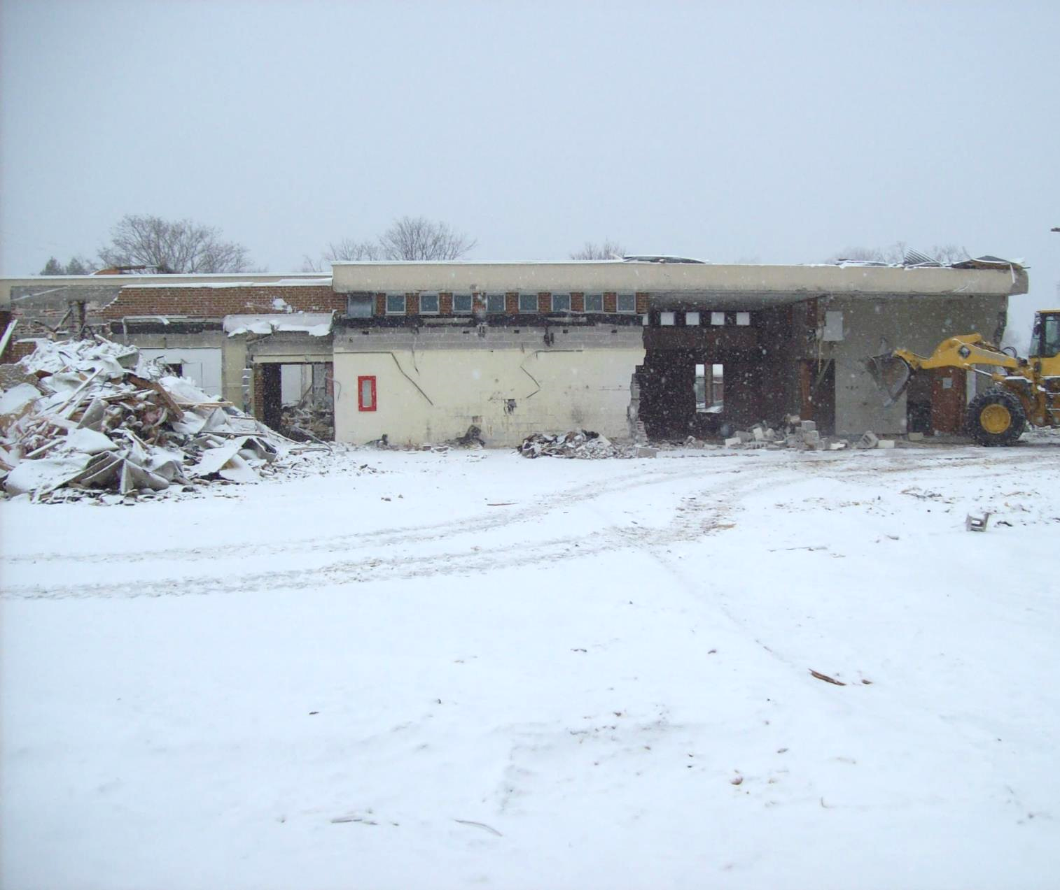
Brownfield Project Examples

Slide 17
Barrel + Beam
Marquette Township, Michigan
Population 3,912

Slide 18
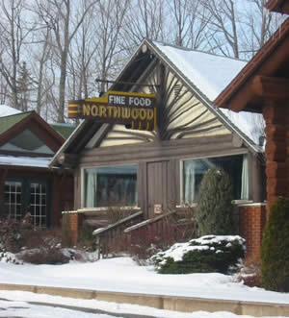
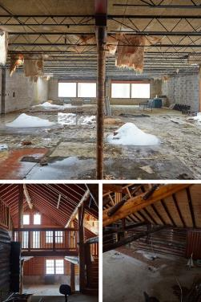
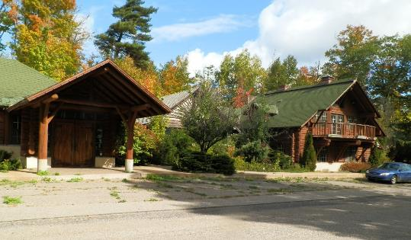
Barrel + Beam
Opened in 1934 – Northwoods Supper Club
Closed in 2007 and remained vacant
Designated “functionally obsolete” by the local assessor
Redevelopment complete in 2018
Brewery focusing on farmhouse and barrel-aged beer

Slide 19
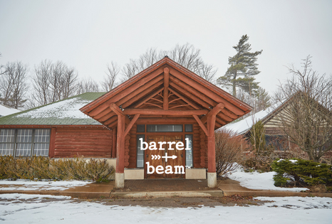
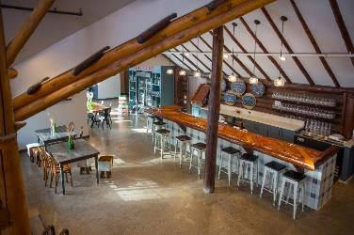
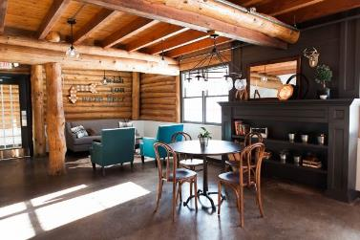
Barrel + Beam - Outcomes
Project Statistics
Private Investment - $900,000
Public Investment - $0
Jobs Retained/Created ~10
Length of Brownfield Plan ~13 yrs.
Funding Sources
EPA Assessment Grant - $10,800
Brownfield TIF Reimbursement - $100,625
Partnerships
Marquette County Brownfield Redevelopment Authority
Marquette Township
Owners – Nick Van Court &
Marina Dupler

Slide 20
Inn on Water Street
Marine City, Michigan
Population 4,083

Slide 21
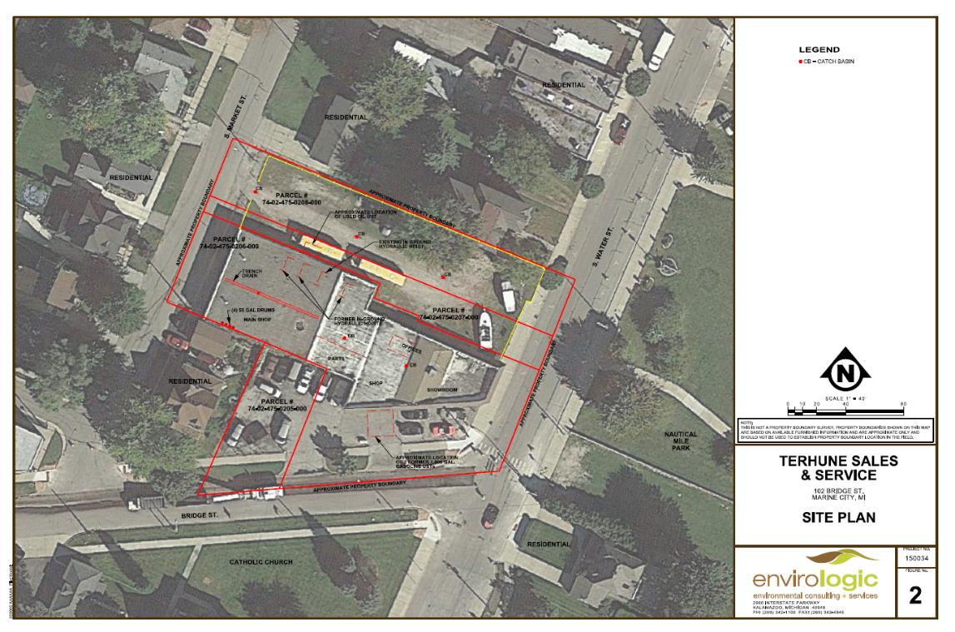
Inn on Water Street

Slide 22
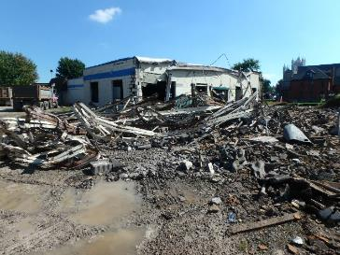
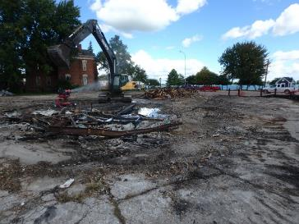
Inn on Water Street
Formerly a car dealership, service center and gas station.
On the St. Clair River.
Contamination concerns included underground storage tanks, waste oil tanks, drains and hydraulic lifts, and contaminated soil.
Original building demolished.
New development supports the existing traditional downtown.
Infrastructure improvements.

Slide 23
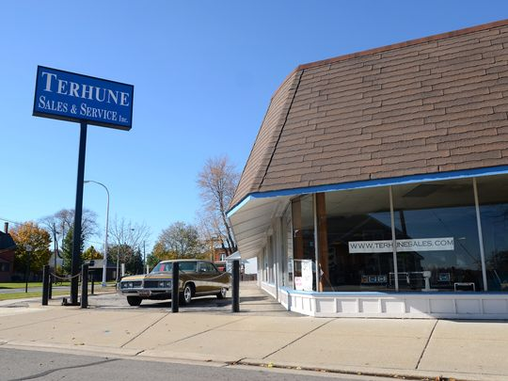
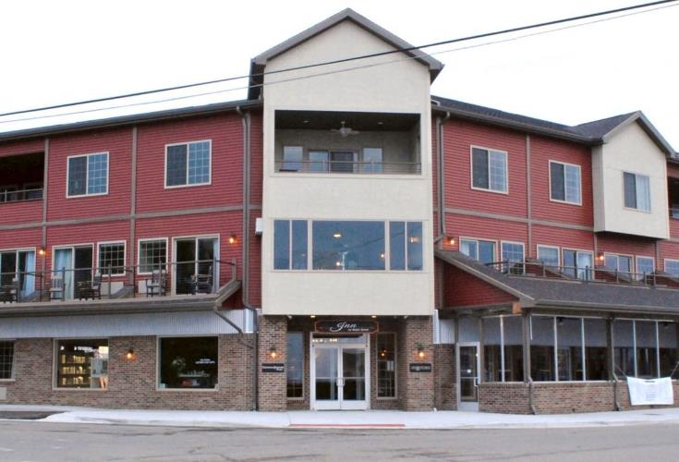
Inn on Water Street
Before
After

Slide 24
Inn on Water Street - Outcomes
Partnerships
Marine City
St. Clair County Brownfield Redevelopment Authority
St. Clair County Economic
Development Alliance
St. Clair County EDA
EGLE, EPA
Project Statistics
Private Investment - $4,200,000
Public Investment - $30,000
Jobs Created ~15
Length of BF Plan - 22 years
LBRF ~$197,000
Funding Sources
EPA Brownfield Assessment Grant - $18,000
Brownfield TIF Reimbursement - $512,000
MEDC Grant & Loan - $642,00
EGLE Grant & Loan - $529,000
Community Foundation of St. Clair County
Marine City Tax Increment Finance Authority
Commercial Redevelopment Exemption - $150,000
Marine City Tax Increment Finance Authority

Slide 25
Teal Lake Senior Living Community
Negaunee, Michigan
Population 4,537

Slide 26
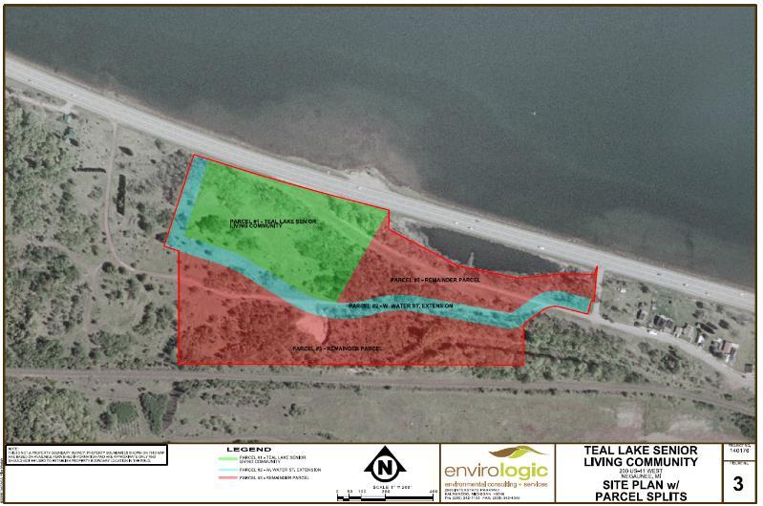

Slide 27
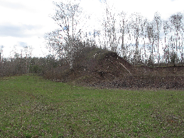
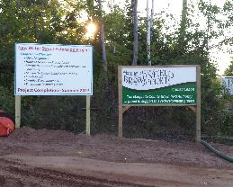
Teal Lake Senior Living Community
The Teal Lake Senior Living Community project served as the catalyst for the revitalization of a 32-acre vacant brownfield site that had been idle since historic mining operations ceased.
Project involved the redevelopment of a former mining operations area with waste rock piles, contaminated soil and other debris.
Included an extension of a road and utilities.
Construction of a 32,000-square-foot, 40-unit assisted living facility.
A Brownfield Plan, in conjunction with the Marquette County Land Bank, was utilized to off-set eligible environmental and non-environmental costs.
Notes:
Anne

Slide 28
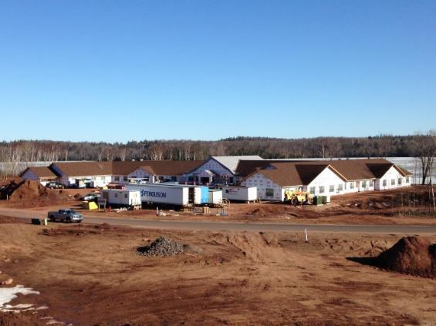
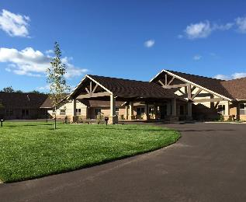
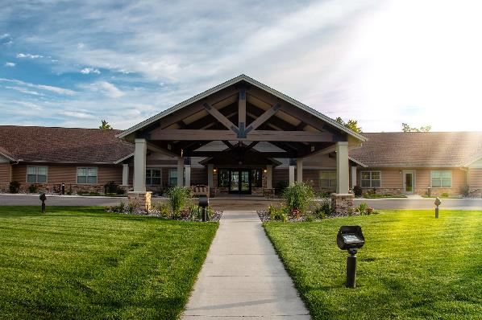
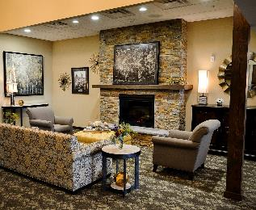
Teal Lake Senior Living Community

Slide 29
Teal Lake Senior Living Community -Outcomes
  Partnerships
  City of Negaunee
  Hinkson Negaunee Properties LLC
  Marquette County Brownfield Redevelopment Authority
  Marquette County Land Bank
Project Statistics
Project Investment - ~$5,572,000
Developer Reimbursement - ~$1,500,000
New Jobs – 26
Property Area - 6.4 acres
Funding Sources
EPA Brownfield Assessment Grant - $44,000
City of Negaunee - $172,000
Hinkson Negaunee Properties LLC - $942,000
Marquette County Land Bank - $184,000
Brownfield TIF Reimbursement - $2,514,000

Slide 30
Eddy School
City of St. Clair
Population 5,354

Slide 31
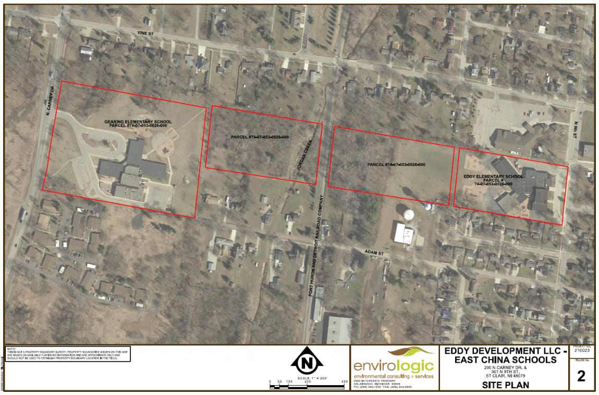
Eddy School

Slide 32
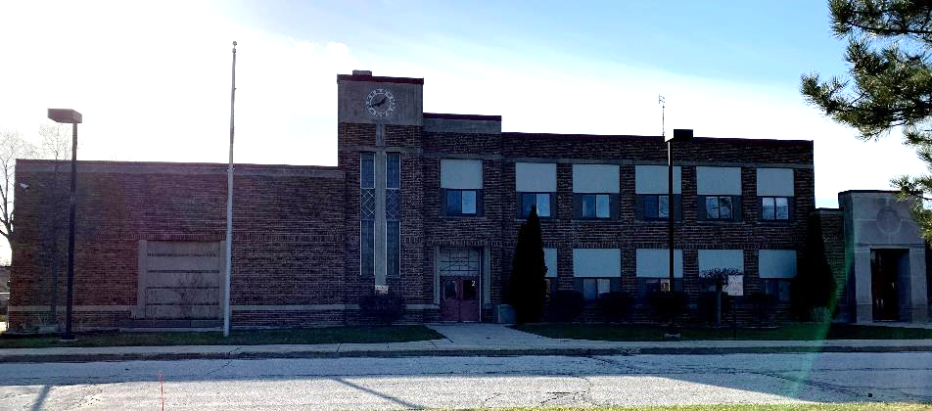
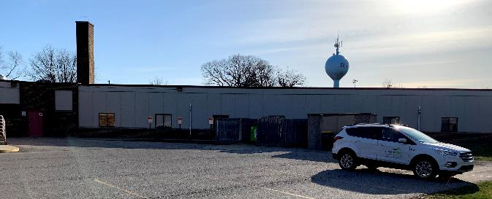
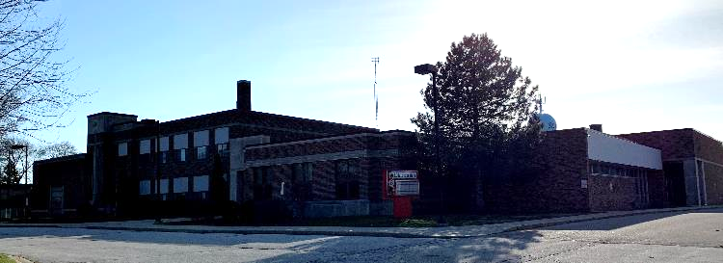
Eddy School

Slide 33
Eddy School
Collaborative effort between land bank and school system.
Land bank acquired property, lease back on one of the schools for three years.
Adaptive reuse plan for two excess elementary school buildings on a single parcel of land.
The Eddy School building has been redeveloped for an assortment of community, non-profit, and commercial office spaces.
Vacant land between these two schools will be used for senior housing development, including assisted living and independent living.
The second school property specific end uses are not defined.

Slide 34
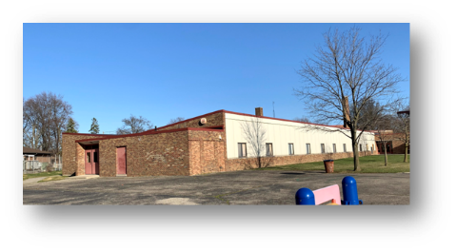
Eddy School - Outcomes
Partnerships
Eddy Development LLC
St. Clair County Brownfield Redevelopment Authority
St. Clair County Land Bank
City of St. Clair
Project Statistics
Private Investment - $25,000,000
Public Investment - $0
Jobs Created – 35
6-year Brownfield Plan
Two schools redeveloped
56,000 sq.ft. senior housing
Senior Independent living
Funding Sources
EPA Brownfield Assessment Grant - $34,262
Private investment - $25,00,000 ($7M for the two schools & $18M for the senior housing project.)
Land Bank 5/50 Specific Tax
50/50 Split in new taxes to taxing jurisdictions and BRA
$300,000 to developer
$287,000 to LBRF

Slide 36
DeShano Homes
Gladwin, MI
Population 2,888

Slide 37
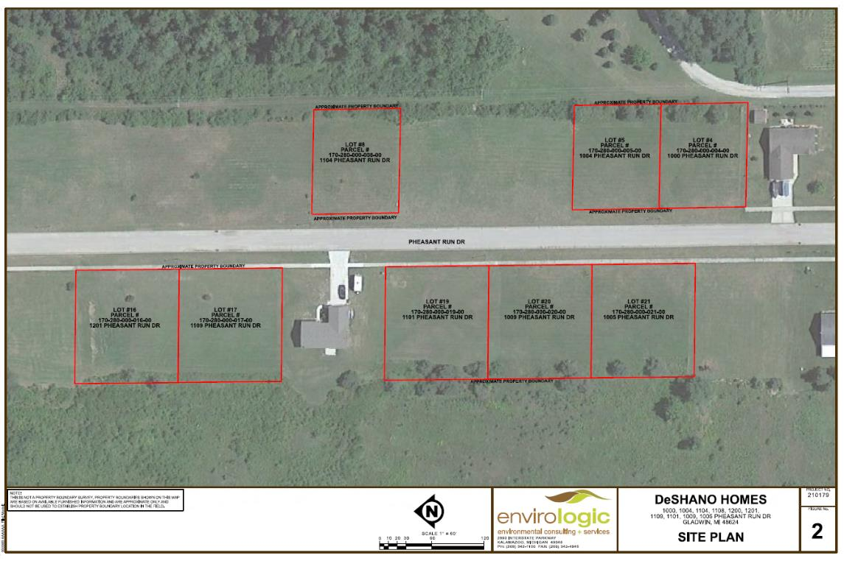
DeShano Homes

Slide 38
DeShano Homes
Vacant land owned by DeShano Homes – 8 parcels.
Need for available, attainable housing in Gladwin.
Increase availability of attainable housing and be conveyed to buyers making no more than 100% of the Area Median Income (AMI).
Public-private partnership between the Gladwin County Land Bank Authority, Gladwin County Brownfield Redevelopment Authority and DeShano Homes.
Will allow developer to convey the homes at a discounted price based on the financing abilities of the prospective purchaser.
  Discount will be reimbursed through future property taxes.
  This “cost of conveying the property” is an eligible activity under the Act and allows the local unit of government to assist in the construction of sorely needed attainable housing stock.

Slide 39
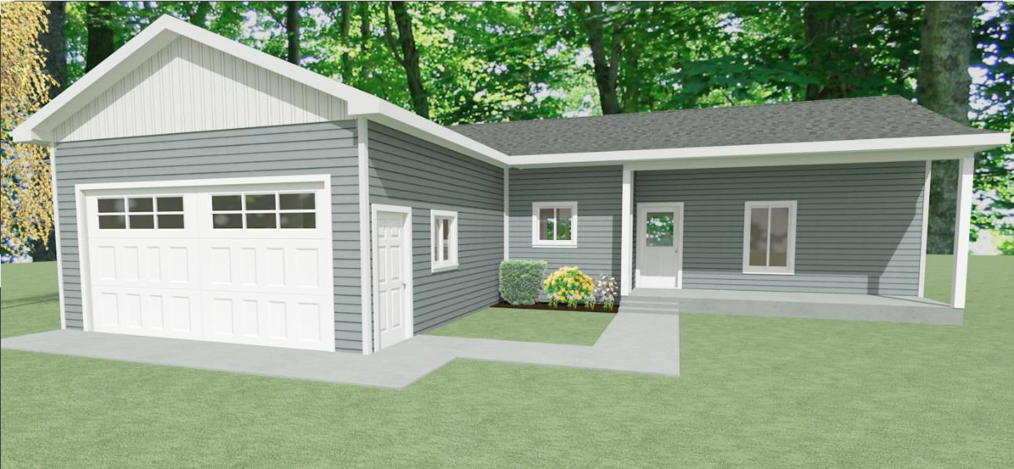
DeShano Homes

Slide 40
DeShano Homes – Estimated Outcomes
8 single-story homes approximately 1,267 square feet with an attached garage
$1.2 million total investment
$13,955 initial taxable value
$606,000 future taxable value, provided by the City Assessor
16 years until the developer is fully reimbursed, 5 full years of LBRF capture
$17,051 Authority administration fees
$240,590 maximum amount of Developer eligible activities to be reimbursed (approx. $30,000/home)
$105,436 amount to be deposited in Local Brownfield Revolving Fund
$53,088 5/50 capture to the Gladwin County Land Bank Fast Track Authority
$7,762 amount to be deposited in State Revolving Fund

Slide 41
Maas Street Development
Negaunee, MI
Population 4,537

Slide 42
Maas Street Development

Slide 43
Maas Street Development

Slide 44
Maas Street Development
Developing 27 residential lots
Needed assistance from MCBRA and Land Bank to use brownfield TIF to address infrastructure costs
Single-family approximately 1,200 square feet
Infrastructure costs include road construction and utilities
City of Negaunee supporting project
Development and infrastructure costs $1,200,000.
Provides workforce/missing middle housing.

Slide 45
Wrap Up
Brownfield Redevelopment and Land Bank Authorities are very powerful economic development tools.
Be creative and innovative when applying these tools – flexibility is possible.
Bring Brownfield discussion to the potential development early.
Become aware of the tools and their potential applicability to your community and/or project.
Understand what your community/residents/elected officials will embrace.
Not everyone is supportive of “government subsidization” or “developer enrichment.”
Recognize that one tool/incentive will likely not be the “silver solution” to help realize your goals or objectives.
Layering tools, incentives and funding is usually necessary.
Brownfield redevelopment is economic development.
Have your tools and resources ready!

Slide 46



Envirologic
Jeff Hawkins,
CEO/Hydrogeologist
  Hiker 1%er
  Biker
  Kayaker
  Favorite foods: ice cream and
  bourbon

Slide 47
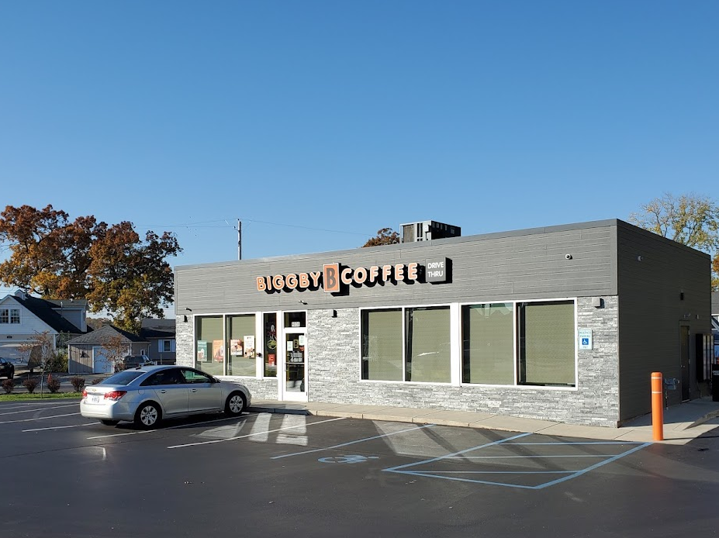



Contact – Jeff Hawkins, CEO
(800) 272-7802
jhawkins@envirologic.com
www.envirologic.com

