Slide 1
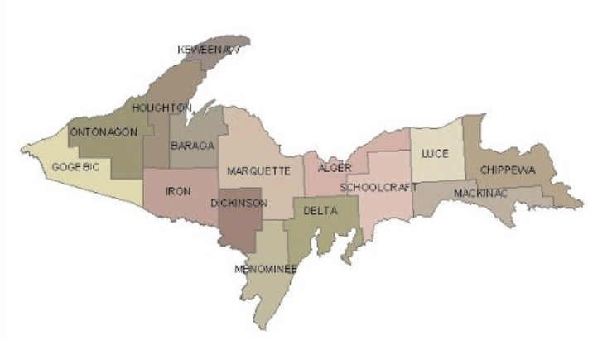
The American Rescue Plan Act Its Impact on UP Counties
Scott Erbisch, Marquette County Administrator
Anne Giroux, Marquette County Finance Manager

Slide 2
What is ARPA?
The American Rescue Plan Act of 2021 (ARPA) provided approximately $1.9 trillion in stimulus funding to individuals, businesses, and governments in response to the COVID-19 pandemic. This included allocations to state and local governments.
Outside of allocations to state and local government, several of the tax credits, small business grants and other funds provided by ARPA will impact UP residents.

Slide 3
State and Local Fiscal Recovery Fund (SLFRF) Allocations
ALGER | $1,769,122
BARAGA | $1,594,502
CHIPPEWA | $7,254,605
DELTA | $6,950,623
DICKINSON | $4,902,380
GOGEBIC | $2,714,480
HOUGHTON | $6,931,199
IRON | $2,149,441
KEWEENAW | $411,008
LUCE | $1,209,910
MACKINAC | $2,097,579
MARQUETTE | $12,955,499
MENOMINEE | $4,424,748
ONTONAGON | $1,111,043
SCHOOLCRAFT | $1,572,165
State of Michigan: $5.6 billion
Counties in Michigan: $1.93 billion
Metropolitan cities in Michigan: $1.8 billion
Non-entitlement units (NEU) of local government: $644 million
(NEU: cities, villages and towns with populations under 50,000)

Slide 5
Four Broad Eligible Uses
Public Health and economic impacts – to respond to the public health emergency with respect to COVID-19 or its negative economic impacts
Premium Pay – For eligible workers performing essential work during the COVID-19 public health emergency
Revenue Loss – For the provision of government services to the extent of the reduction in revenue
Infrastructure – To make necessary investments in water, sewer, or broadband infrastructure

Slide 6
Revenue Loss
Two methods available for determining revenue loss – by formula or elect “standard allowance” of $10 million (not to exceed award amount). For all UP counties except Marquette, the standard allowance can be used.
Adopting the “standard allowance” of $10 million offers a simple and convenient method to determining revenue loss.
Revenue loss is an advantageous category due to substantial flexibility. “Government services” includes any service traditionally provided by government.
Documentation of expenses is required
Revenue loss is not “free money” and must still be used toward government services.

Slide 7
Restrictions
Cannot pay interest or principal on outstanding debt
Cannot replenish rainy day or other reserve funds – cannot simply “set the money aside”
Cannot pay settlements or judgments
Cannot be used to directly or indirectly offset tax reductions or delay a tax/tax increase
Cannot be deposited into any pension fund

Slide 8
Spending of Funds – Strategic considerations
Funds must be obligated by December 31, 2024 and spent by December 31, 2026. “Obligation” is per the definition in Uniform Guidance: Financial obligations, means orders placed/contracts entered into for property and services.
Consider materials/product shortages, availability of contractors, etc.
Whose input will be considered? Will you provide an opportunity for public comment/submission of proposals?
Avoid taking on recurring costs
Other funding opportunities will be available through the State and Federal Government
What opportunities are there to collaborate with local units of government or leverage funds for State/Federal opportunities?

Slide 9
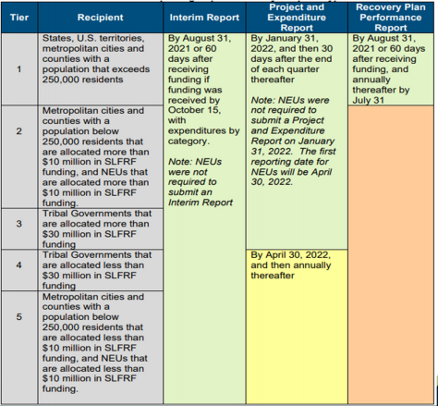
Reporting
Even if choosing revenue loss, you will still need to quantify and report amounts expended.
Reporting User guide is on Treasury’s website: https://home.treasury.gov/system/files/136/April-2022-PE-Report-User-Guide.pdf

Slide 10
Audit Requirement
Funds are subject to administrative requirements and cost principles under Uniform Guidance.
Understand Uniform Guidance requirements – internal control requirements, written policies that are needed (conflict of interest, procurement, travel, fringe/leave, cash management, etc.)
Awards are subject to Single Audit. A Single Audit is required for non-Federal entities that expend over $750,000 in Federal awards in a given fiscal year.
Documentation is key

Slide 11
Marquette County –process and spending plan
December 7, 2021 – Initial county board work session, review of guidance, preliminary spending plan approved for 65% of funds.
March 15, 2022 – Second county board work session. Included public comment period. Approval of spending plan allocating 99% of funds.
Identified review criteria/guidelines
Provided ongoing public input mechanism via county website

Slide 12
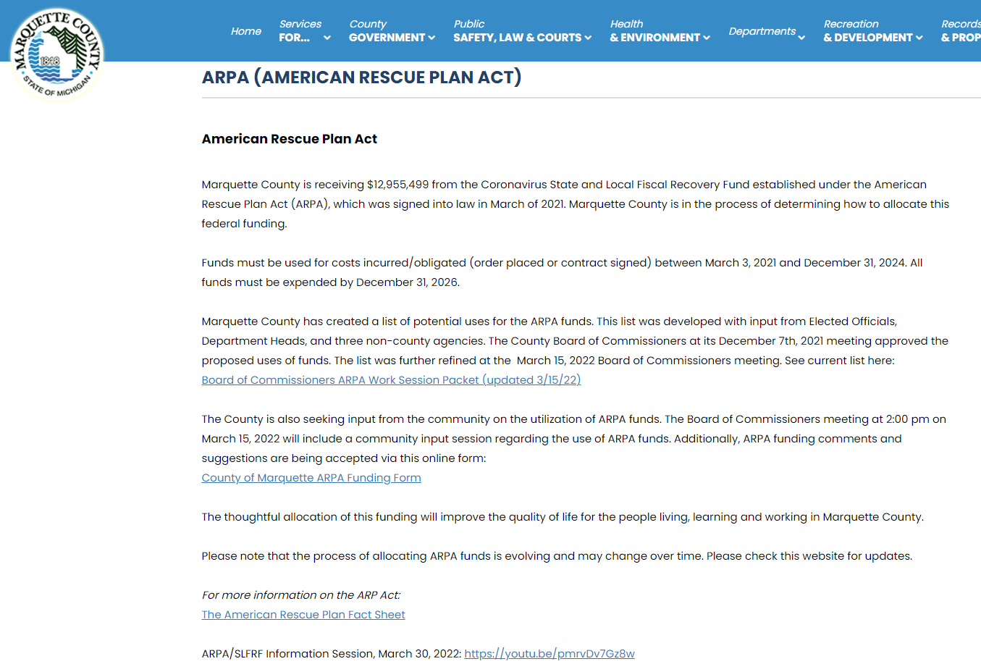
https://www.co.marquette.mi.us/arpa.php

Slide 13
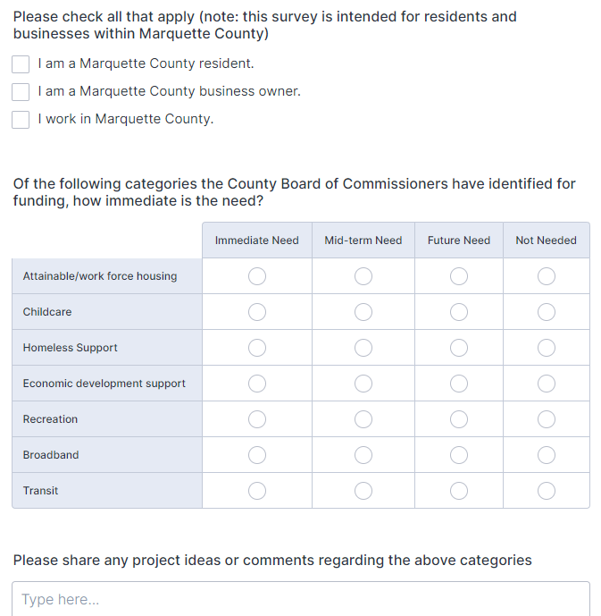
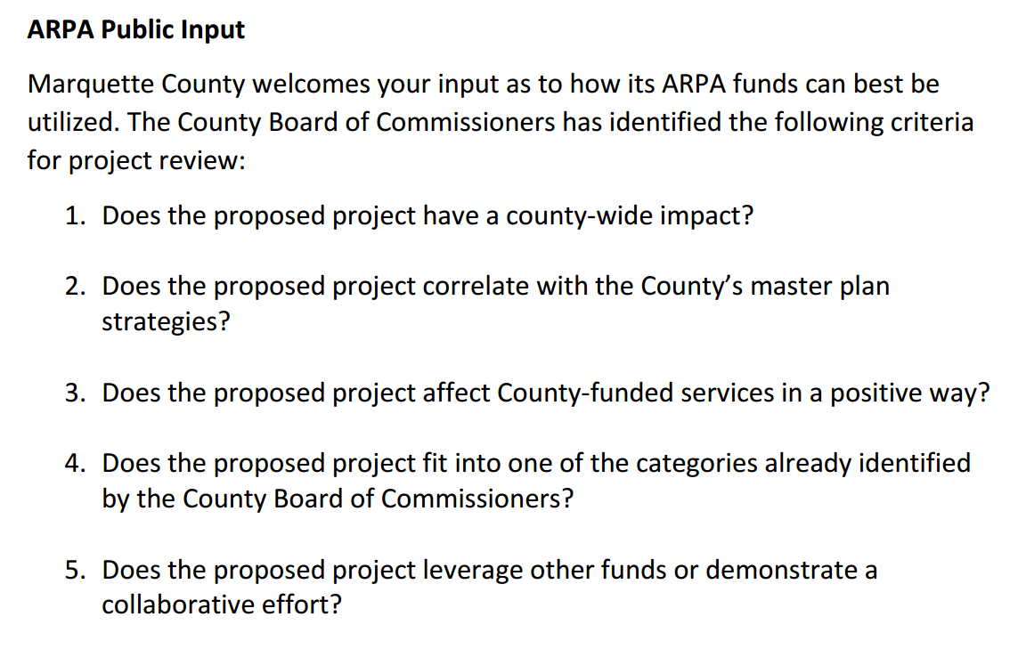
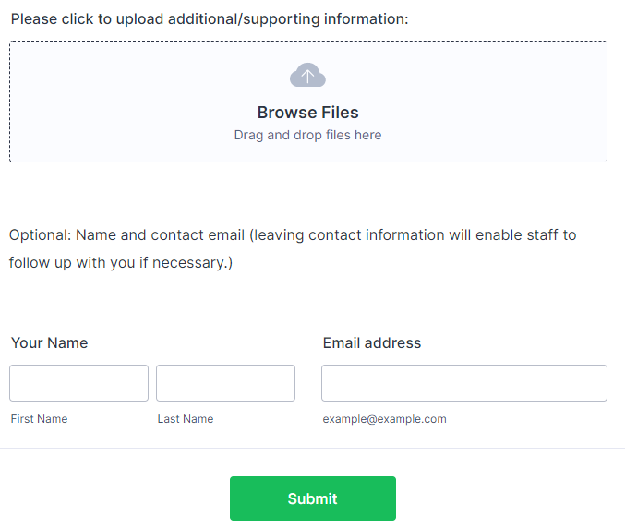

Slide 14
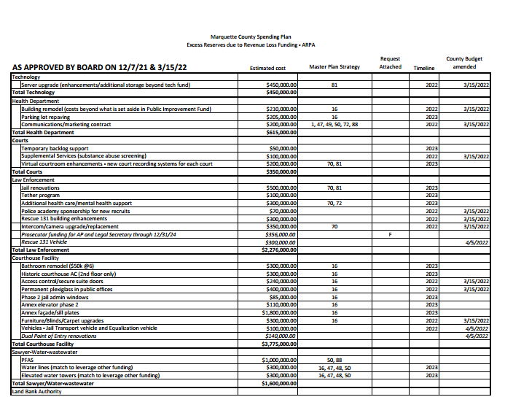

Slide 15
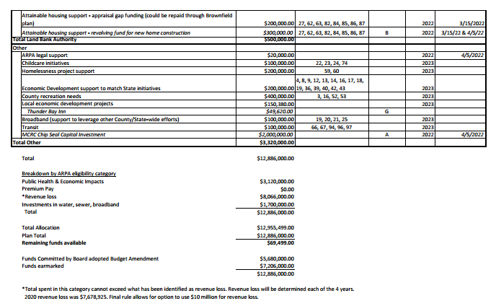

Slide 16
Questions?
Contact Information
Scott Erbisch, Marquette County Administrator
906-225-8151 serbisch@mqtco.org
Anne Giroux, Marquette County Finance Manager
906-225-8177 agiroux@mqtco.org
The information provided is a general summary compiled from information provided at various seminars and is being distributed with the understanding that Marquette County is not rendering tax, accounting, legal or other professional services advice or opinions on specific facts or matters and, accordingly, assumes no liability in connection with its use. The information is not intended to be used as a basis for any decision or action that may affect your business, organization or situation. Consult a qualified professional advisor before making any such decisions.

