Slide 1
NG911 Update
Tim McKee
NG-911 Program Director
tmckee@pfnllc.net

Slide 2
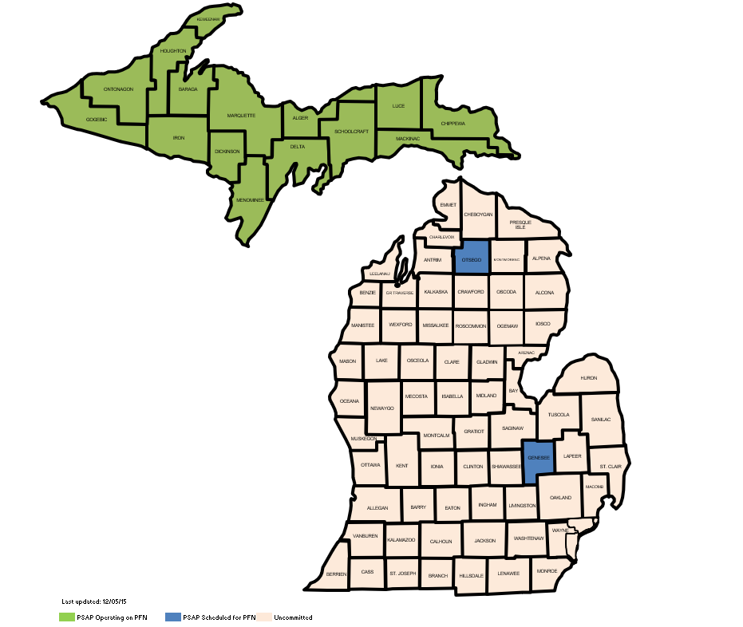

Slide 3
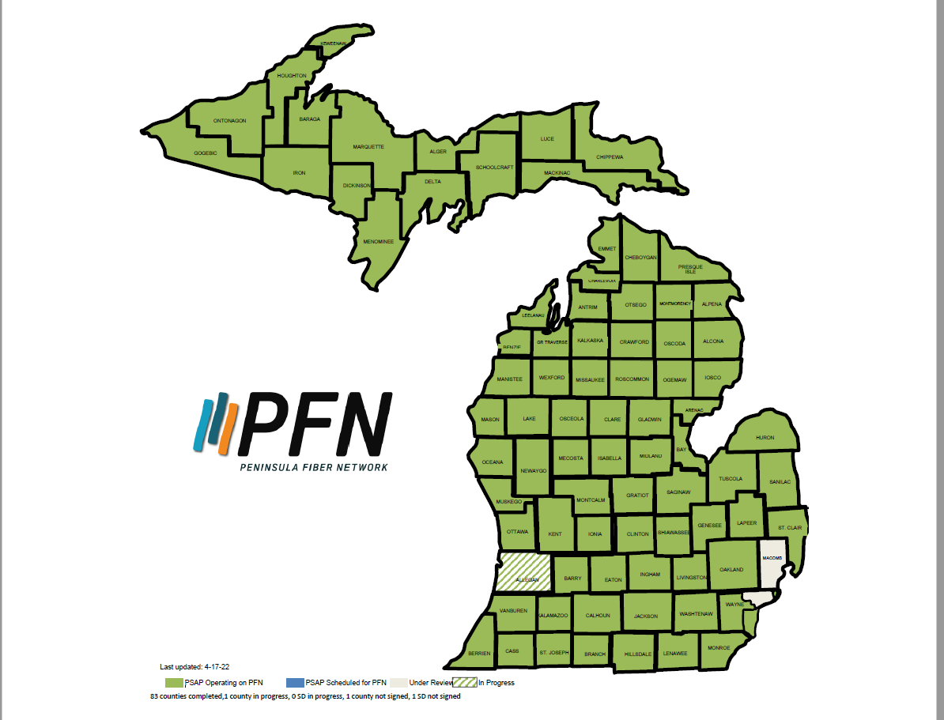

Slide 4
Broadband Partnerships
Jennifer Greenburg
Government Relations
jgreenburg@pfnllc.net

Slide 5
Funding Opportunities
MIHI State Grants
At least $150 million for last mile grants
35% reserved for middle mile grant program ($87 million)
Government buildings/sharing resources
Educational opportunities
Increase access for manufacturing
Economic development tool
Fall/Winter 2022 expected
NTIA Federal Grants
Enabling Middle Mile Infrastructure Grant Program - $1 Billion
Broadband Equity and Deployment Program (BEAD)
Notice of Funding May 16th

Slide 6
Commonalities
Unserved/ Underserved
Anchor Institutions
Partnerships

Slide 7
Partnerships are not….
Own network
Operate Network
Provide Matching Dollars

Slide 8
Partnerships can also …
Identify Needs – Anchor Institutions
Generate Community Support
Rights-of-Way Placement
Streamline Permit Process
Letters of Support
Public Agreement to Use Network

Slide 9
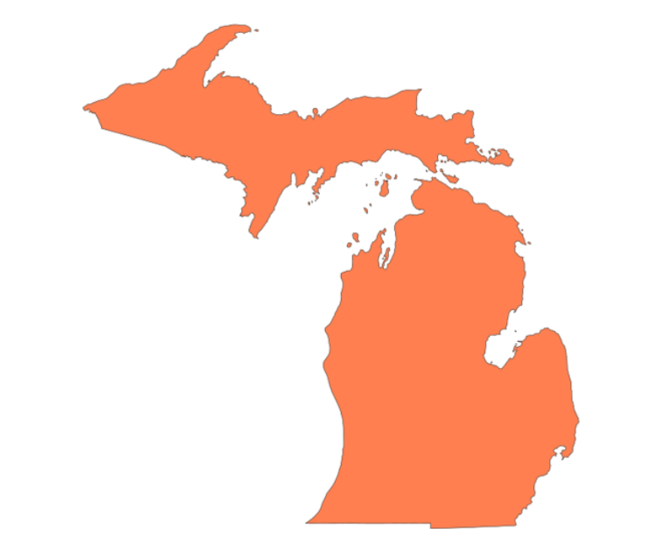

Slide 10
Questions?
Jennifer Greenburg
Vice President of Government Affairs
jgreenburg@pfnllc.net
517-449-2385

